Slide 1

OpenDSS Training
Workshop
Roger C. Dugan
Sr. Technical Executive, EPRI
With
Robert F. Arritt – EPRI
Thomas E. McDermott – Univ. of Pittsburgh
Hosted by FirstEnergy
47 North Main St, Akron, OH, 22-23 Jan, 2013

Slide 2
Agenda
Day 1
  Introduction and Installation
    Break
  Circuit Modeling and Scripting
    Lunch
  Detailed Scripting (Arritt)
    Break
  Introduction to the COM Interface (McDermott)
Day 2
  Custom Scripting
  Various Examples

Slide 3
Introduction to
OpenDSS

Slide 4
What is the OpenDSS?
Script-driven, frequency-domain electrical circuit simulation tool
Specific models for:
  Supporting utility distribution system analysis
  Initially designed for the unbalanced, multi-phase North American power distribution systems
  Can also model European-style systems
      These typically have a simpler structure

Slide 5
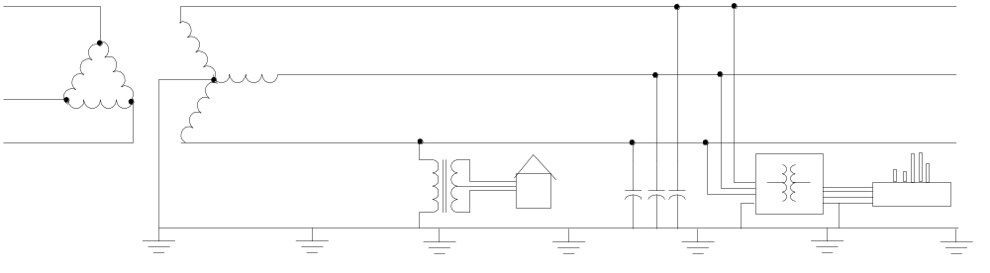
Typical North American Distribution System
Typical 4-wire multi-grounded neutral system
Unigrounded/Delta 3-wire also common on West Coast

Slide 6
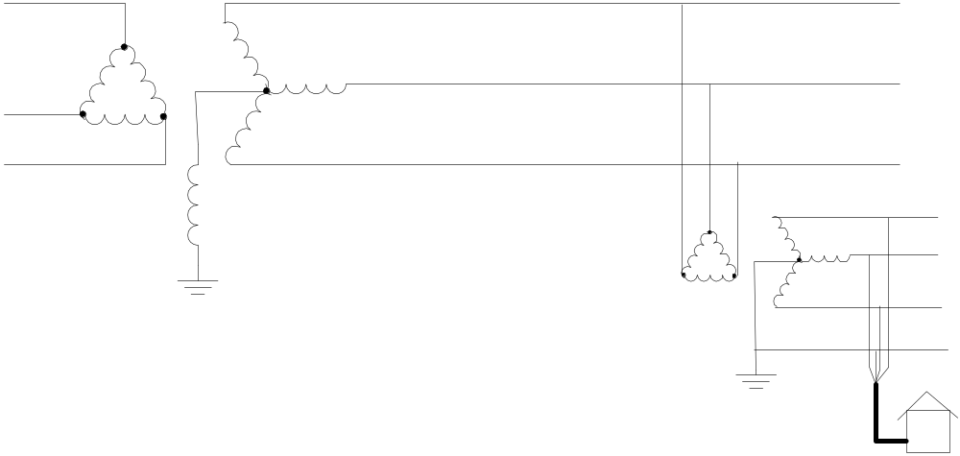
Typical European Style System
  3-wire unigrounded primary
Three-phase throughout,
including secondary (LV)

Slide 7
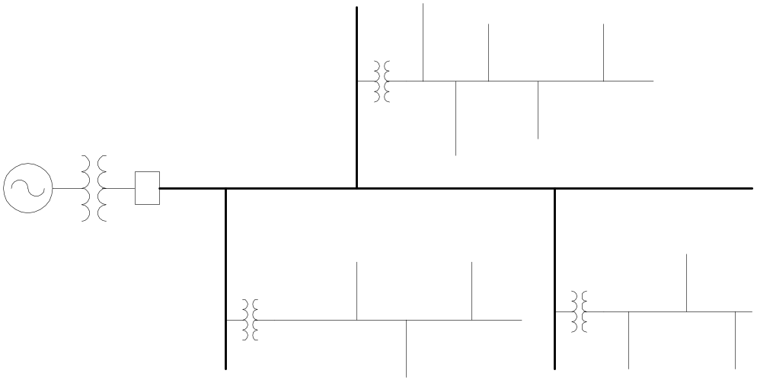
Comparisons of Systems
European-Style System
MV
LV
North American System
MV (ALL)

Slide 8
Comparison of Distribution Systems
North American System
  Primary (MV) system is extensive, complex
  Secondary (LV) is short
  4-5 houses per distribution transformer
    120/240 V single-phase (“split phase”) service
  1 Industrial customer per distribution transformer
    Or multiple transformers per customer
  Extended by adding transformer + wire
European Style System
  MV System has simpler structure
  LV System (400 V) is extensive
  Perhaps 100 residences on MV/LV transformer
    230/400 V 3-phase
  Extended by adding wire
    Fewer transformers

Slide 9
What is the OpenDSS? (cont’d)
Heritage of OpenDSS
  Harmonics solvers rather than power flow
    Gives OpenDSS extraordinary distribution system modeling capability
  Simpler to solve the power flow problem with a harmonics solver than vice-versa
Supports all rms steady-state (i.e., frequency domain) analyses commonly performed for utility distribution system planning
  And many new types of analyses
  Original purpose in 1997: DG interconnection analysis

Slide 10
What is the OpenDSS? (cont’d)
What it is NOT
  An Electromagnetic transients solver (Time Domain)
    It can solve Electromechanical transients
      Frequency Domain => “Dynamics” mode
      All solutions are in phasors (complex math)
  Not a “Power Flow” program
  Not a radial circuit solver
    Does meshed networks with equal ease
  Not a distribution data management tool
    It is a simulation engine designed to work with data extracted from one or more utility databases

Slide 11
Time- and Location-Dependent Benefits
The OpenDSS was designed to capture both
  Time-specific benefits and
  Location-specific benefits
Needed for
  DG analysis
  Renewable generation
  Energy efficiency analysis
  PHEV and EV impacts
  Other proposed capacity enhancements that don’t follow typical loadshapes

Slide 12
Time- and Location-Dependent Benefits
Traditional distribution system analysis programs
  Designed to study peak demand capacity
  Capture mostly location-specific benefits
  Ignores time; assumes the resource is available
  This gets the wrong answer for many DG, energy efficiency, and Smart Grid analyses
Must do sequential-time analysis to get the right answer
  Over a distribution planning area
  Over a significant time period
    Year, Month, or Week

Slide 13
Built-in Solution Modes
Snapshot (static) Power Flow
Direct (non-iterative)
Daily mode (default: 24 1-hr increments)
Yearly mode (default 8760 1-hr increments)
Duty cycle (1 to 5s increments)
Dynamics (electromechanical transients)
Fault study
Monte carlo fault study
Harmonics
Custom user-defined solutions

Slide 14
Controls
A key feature is that controls are modeled separately from the devices being controlled
  Capacitors
  Regulators/tapchangers
  Storage controllers
  Inverter control
  Switch control
  Relays, Reclosers, Fuses are controls

Slide 15
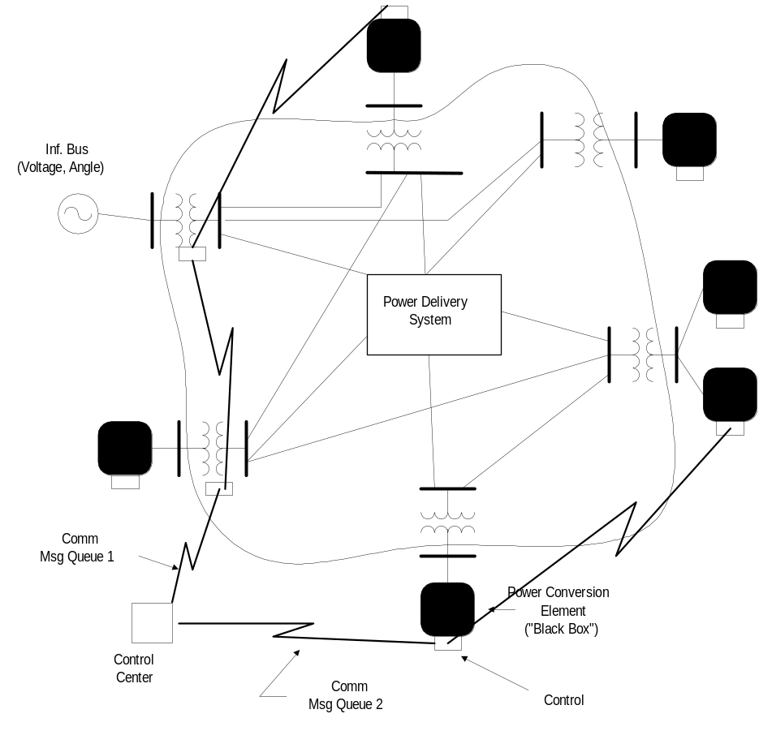
Overall Model Concept

Slide 16
Control Modes
Static
  Power flows with large time steps
Time
  Control queue employed to delay actions
  Control acts when time is reached
Event

Slide 17
User Interfaces Currently Implemented
A stand-alone executable program that provides a text-based interface (multiple windows)
  Some graphical output is also provided.
  No graphical input is provided.
An in-process COM server (for Windows) that supports driving the simulator from user-written programs.
  32-bit and 64-bit (New in 2012)
EPRI Program 174 funders have access to DGScreener, an interface to OpenDSS

Slide 18
Validation of OpenDSS
EPRI routinely checks OpenDSS power flow results against CYME, SYNERGEE, WindMil, and other programs after converting data sets for various projects.
The OpenDSS program has been benchmarked against all the IEEE Test Feeders
  (http://ewh.ieee.org/soc/pes/dsacom/testfeeders/).
  OpenDSS was used to develop the NEV test feeder and the 8500-node test feeder.
  Being used to develop the DG Protection test feeder and the large urban network test feeder.
For the EPRI Green Circuits project, computed load characteristics were calibrated against measured data.
Recently, the new PVSystem model was compared to actual measurements with excellent results.

Slide 19
Introduction to
OpenDSS
Uses and Applications
Some examples to inspire you…

Slide 20
What can OpenDSS be used for?
Simple power flow (unbalanced, n-phase)
Daily loading simulations
Yearly loading simulations
Duty cycle simulations
  Impulse loads
    Rock crushers
    Car crushers
  Renewable generation

Slide 21
What can OpenDSS be used for?
DG
  Interconnection studies/screening
  Value of service studies (risk based)
  Solar PV voltage rise/fluctuation
  Wind power variations impact
  Hi-penetration solar PV impacts
  Harmonic distortion
  Dynamics/islanding

Slide 22
What has OpenDSS be used for?
Hybrid simulation of communications and power networks
Geomagnetically-Induced Current (GIC) flow (solar storms)
Power delivery loss evaluations (EPRI Green circuits program - > 80 feeders)
Voltage optimization
PEV/PHEV impact simulations
Community energy storage (EPRI Smart Grid Demo)
High-frequency harmonic/interharmonic interference
Various unusual transformer configurations
Transformer frequency response analysis
Distribution automation control algorithm assessment
Impact of tankless electric water heaters
Wind farm collector simulations
Wind farm interaction with transmission
Wind generation impact on capacitor switching and regulator/LTC tapchanger operations
Protection system simulation
Open-conductor fault conditions
Circulating currents on transmission skywires
Ground voltage rise during faults on lines
Stray voltage simulations
Industrial load harmonics studies/filter design
Distribution feeder harmonics analysis, triplen harmonic filter design
And many more ….

Slide 23
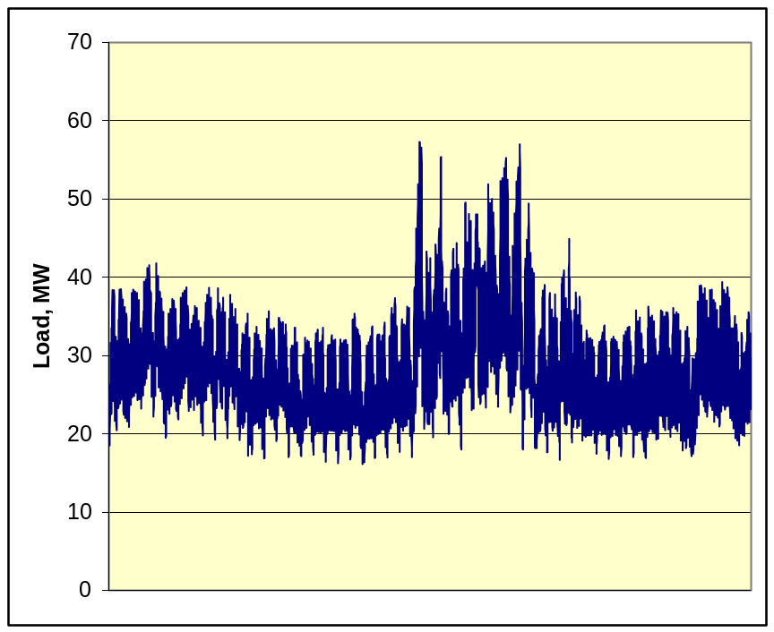
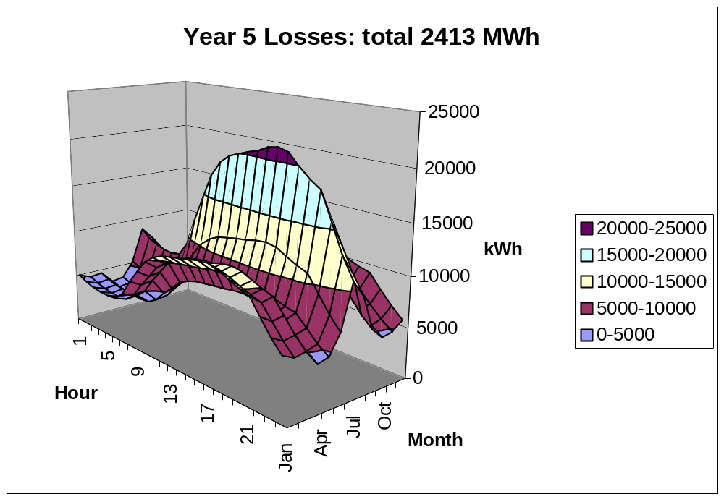
Computing Annual Losses
Peak load losses are not necessarily indicative of annual losses

Slide 24
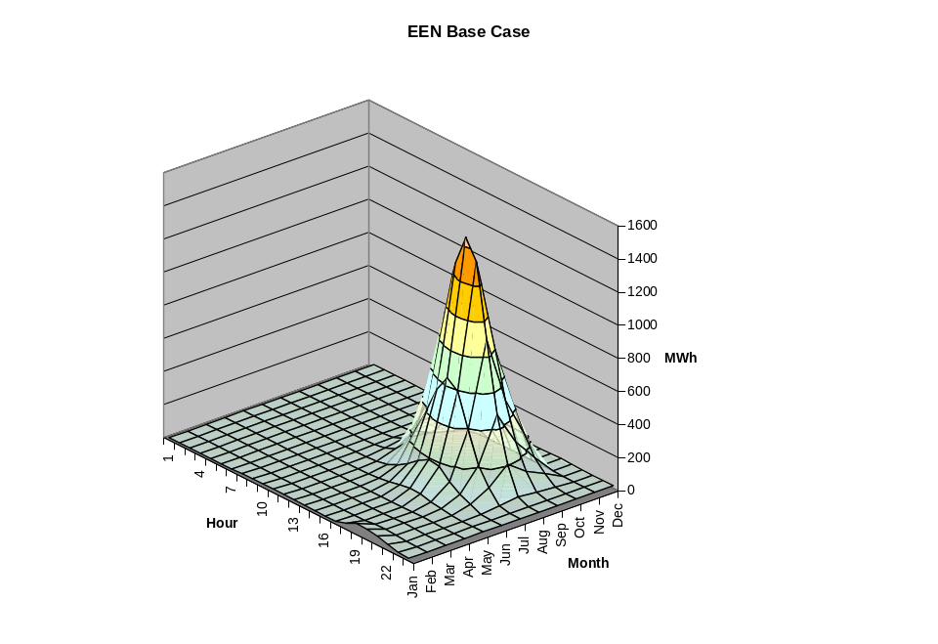
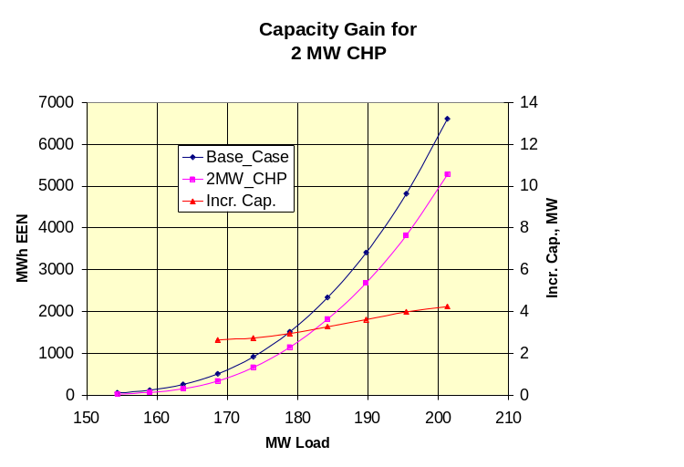
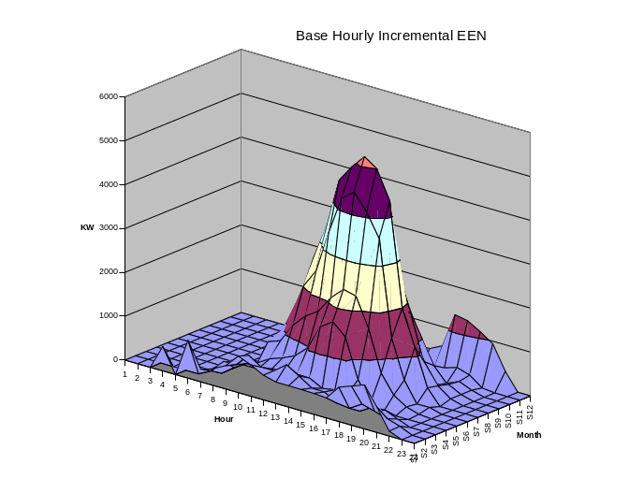
Using DSS to Determine Incremental Capacity of DG
“Needle” Peaking System
“How much more power can be served at the same risk of unserved energy?”
Broad Summer Peaking System

Slide 25
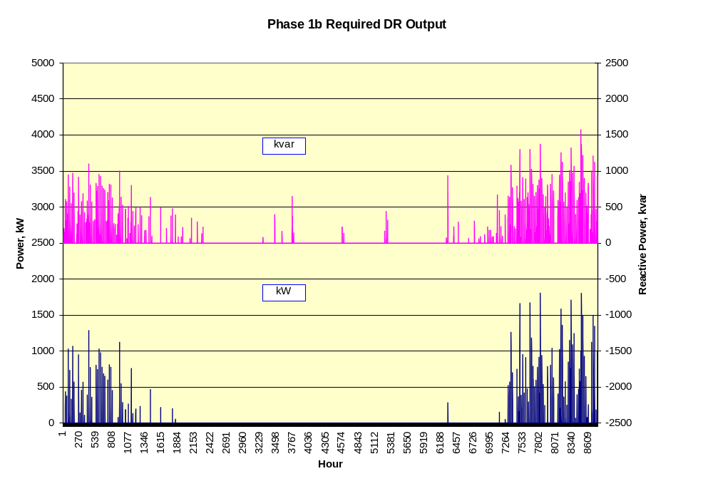
DG Dispatch

Slide 26
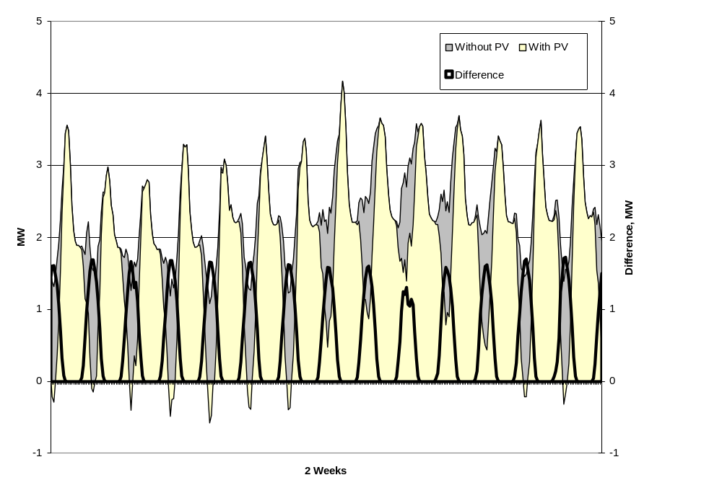
Solar PV Simulation – 1 h step size

Slide 27
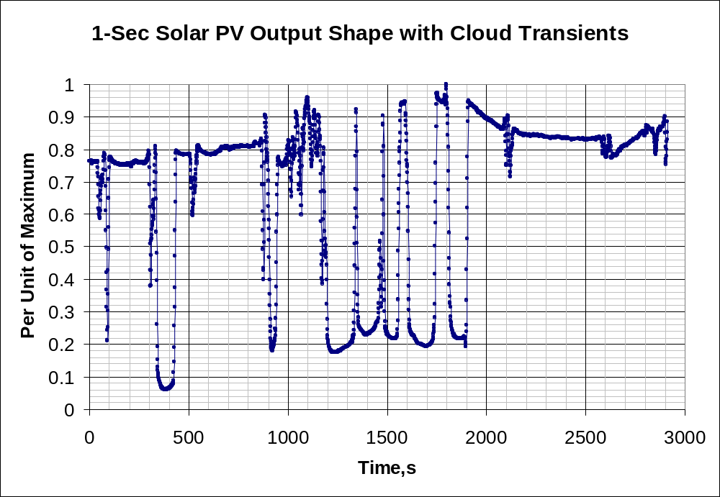
1-s Solar Data – Cloud Transients
Impact on Feeder Voltage ??

Slide 28
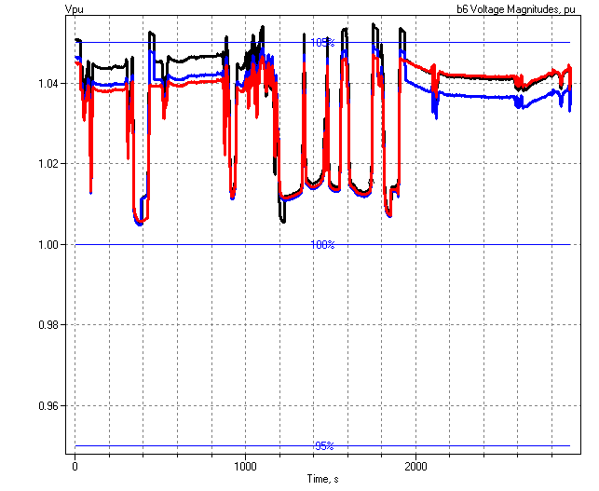
1-sec Solar Data (2010)
Regulator Operations

Slide 29
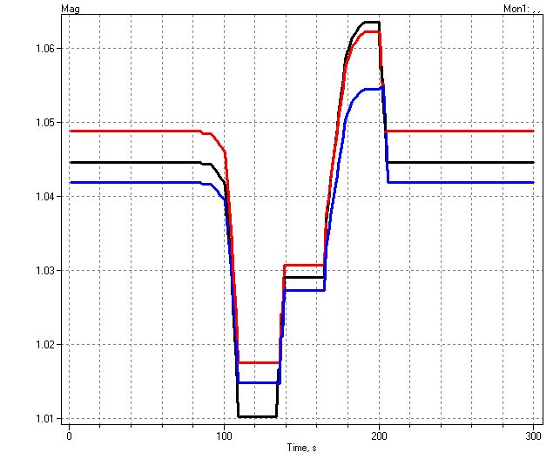
Example of an Expected DG Problem
Voltage overshoots as power output ramps up
Regulator taps up to compensate for voltage drop

Slide 30
Root of Problem
p.u. Voltage
Voltage Profile w/ DG
1.10
Distribution Systems designed for voltage DROP, not voltage RISE.
High Voltages
1.05
1.00
0.95
0.90
0.0
2.0
4.0
6.0
Distance from Substation (km)

Slide 31
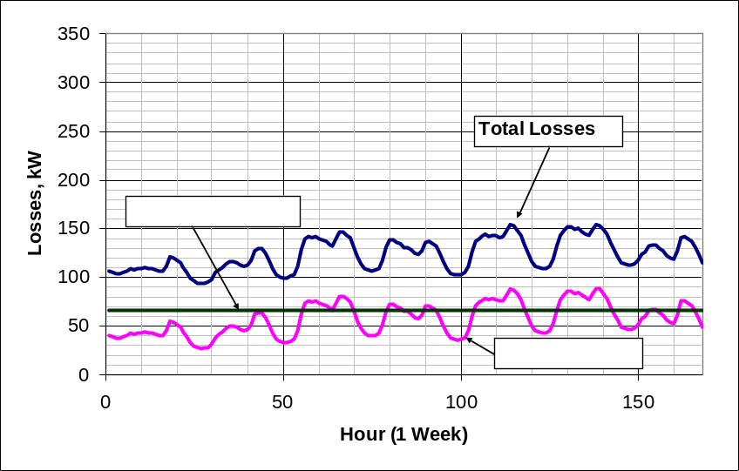
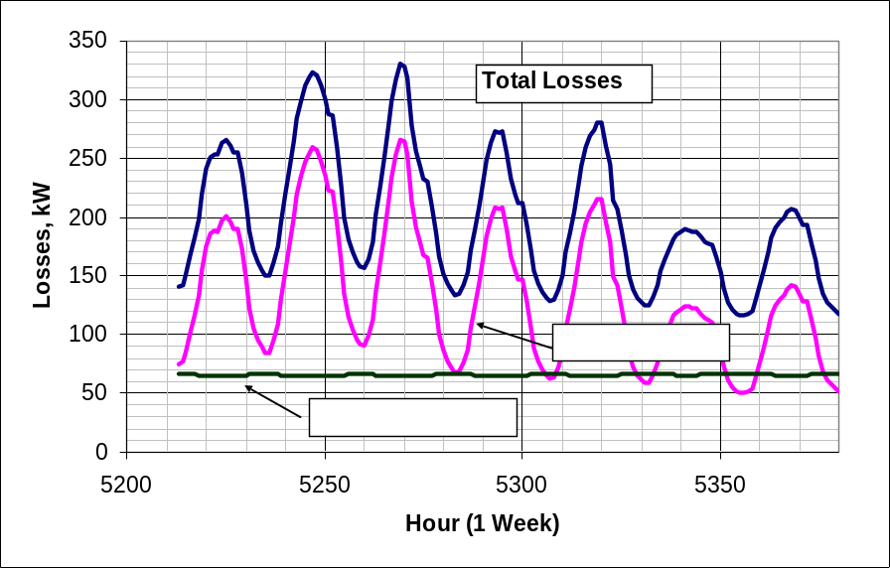
Power Distribution Efficiency
Peak Load Week
Light Load Week

Slide 32
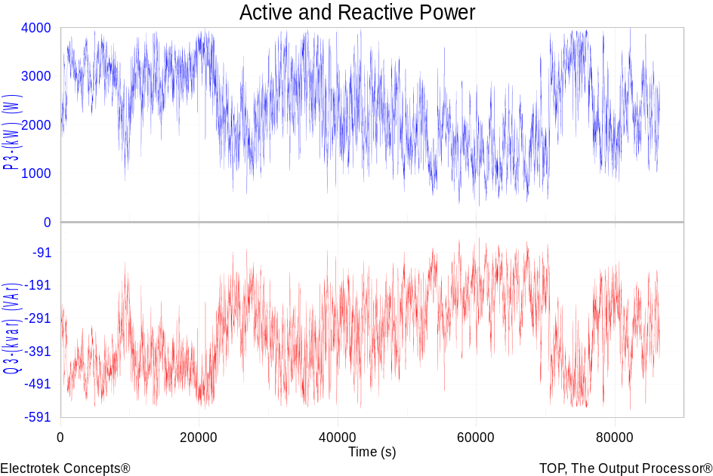
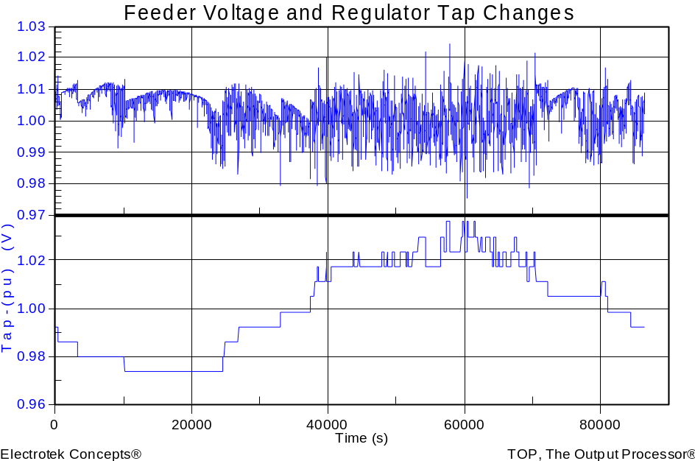
Wind Plant 1-s Simulation
Notes:
The plot you see to the right is a sample case study we did where a developer wanted to install 3 750kW turbines at the end of a 10-mile distribution feeder. Along the feeder was a voltage regulator and large intermittent load. The concern we had was the impact the turbine output fluctuations would have on the flicker, regulator action, as well as the voltage profile along the feeder. Utilizing software that Electrotek had developed, specifically the Distribution System Simulator, or DSS,, minor modifications were made that allowed us to simulate the wind plant fluctuation impact over time, thus giving us the ability to address the concerns at hand.
The plot you see to the right is simulation output from the DSS, over a time horizon of ~ 4 minutes. The three turbines were modeled explicitly, along with the 5-step switched capacitor banks connected to each turbine as well as the voltage regulator upline from the wind plant. This software allows us to make recommendations to the utility and/or wind plant developer regarding modifications necessary, if any, to allow for the wind plant to have minimal impact on the distribution feeder and surrounding customers, or perhaps even improve feeder performance.
We also utilize this software for estimating flicker according the IEC standard 1400-21. The software, along with data specific to the turbine being considered allows one to estimate the flicker impact BEFORE the turbine is installed.

Slide 33
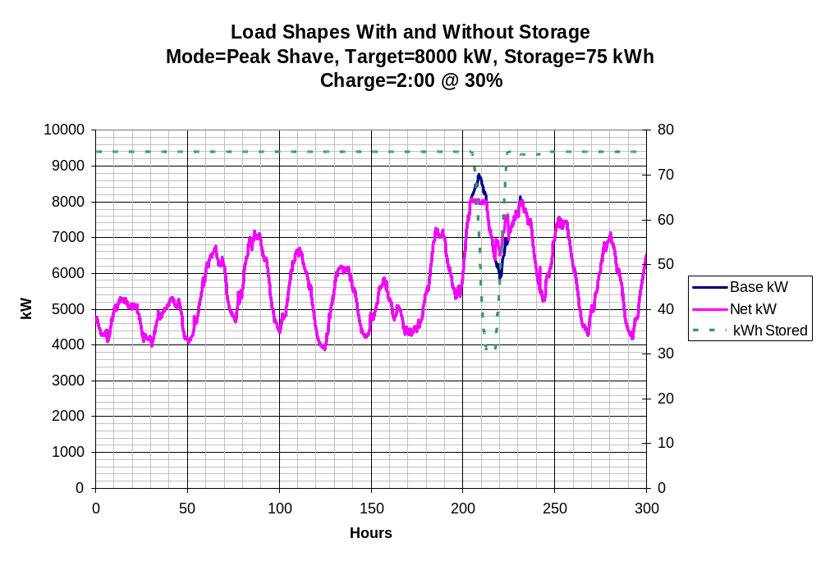
Storage Modeling Simple Peak Shave Example

Slide 34
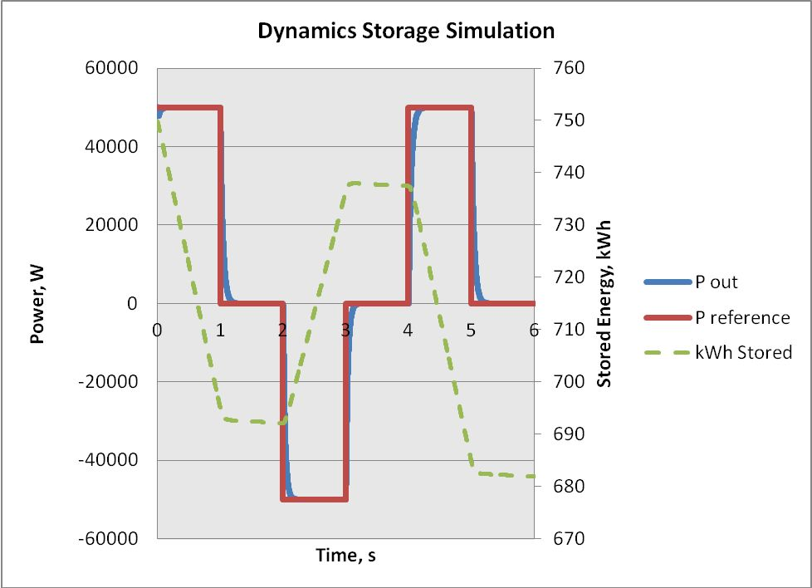
Dynamics Storage Simulation
(Requires separately-licensed DLL)

Slide 35
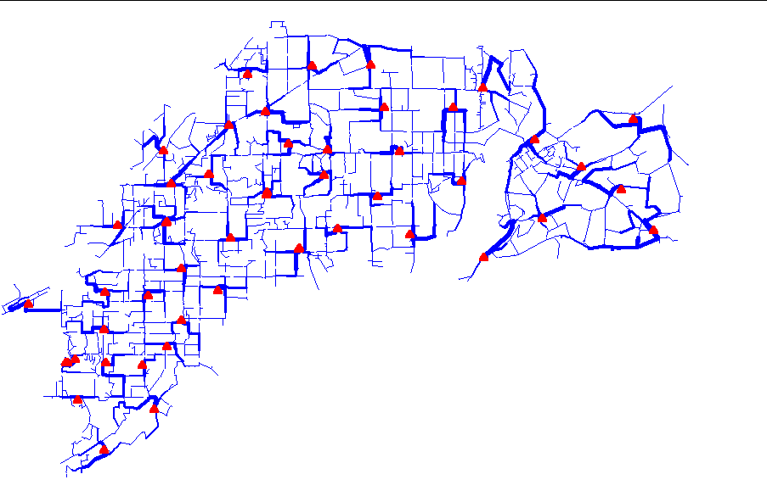
Power Flow Visualization

Slide 36
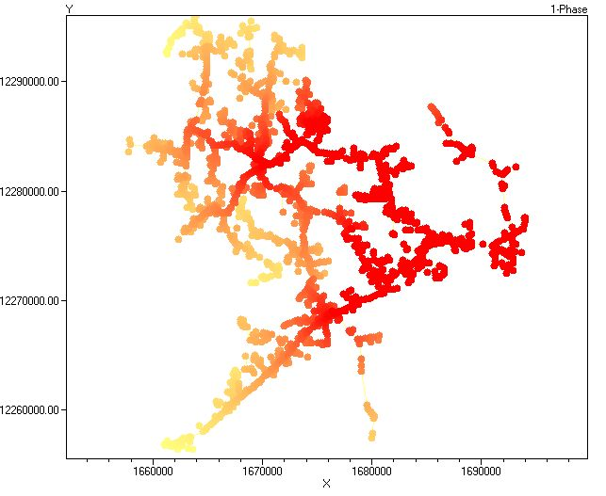
Special Displays
Fault Current Magnitudes

Slide 37
Distribution System Analysis Needs
Why Do We Need a Tool Like This?

Slide 38
Dist Sys Analysis Needs Envisioned by EPRI
Sequential time simulation
Meshed network solution capability
Better modeling of Smart Grid controllers
Advanced load and generation modeling
High phase order modeling ( >3 phases)
  Stray voltage (NEV), crowded ROWs, etc.
Integrated harmonics
  NEV requires 1st and 3rd
User-defined (scriptable) behavior
Dynamics for DG evaluations

Slide 39
EPRI’s Vision
Distribution planning and distribution management systems (DMS) with access to real time loading and control data will converge into a unified set of analysis tools.
Real-time analysis and planning analysis will merge into common tools.
Distribution system analysis tools will continue to play an important role, although they might appear in a much different form than today.

Slide 40
Key Challenges (Ph. D. Suggestions!)
Merging Planning and Real-Time Analysis
Very Large System Models
Systems Communications Simulations
Large Volume of AMI Data
AMI-based Decision Making
Time Series Simulations
Distribution State Estimation

Slide 41
Key Challenges, Cont’d
Detailed LV Modeling
Including multiple feeders, transmission
DG Integration and Protection
Generator and Inverter Models
Meshed (Looped) Network Systems
Regulatory Time Pressures

Slide 42
Getting Started:
Installation and Basic Usage

Slide 43
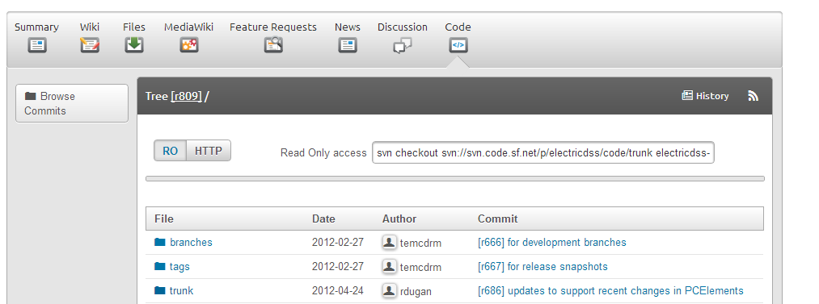
SourceForge.Net Links for OpenDSS
EPRI Links Page
  http://smartgrid.epri.com/SimulationTool.aspx
OpenDSS Download Files:
  http://sourceforge.net/projects/electricdss/files/
Main Page in Wiki
  http://sourceforge.net/apps/mediawiki/electricdss/index.php?title=Main_Page
Top level of Main Repository
May Change

Slide 44
SourceForge.Net Links for OpenDSS
Source Code
  ../Trunk/Source
Examples
  ../Trunk/Distrib/Examples/
  ../Trunk/Distrib/IEEETestFeeders/
  ../Trunk/Distrib/EPRITestCircuits/
IEEE Test Cases
  .. /Trunk/Distrib/IEEETestCases/
Latest Builds (Betas)
  .. /Trunk/Distrib/X86/
  .. /Trunk/Distrib/X64/

Slide 45
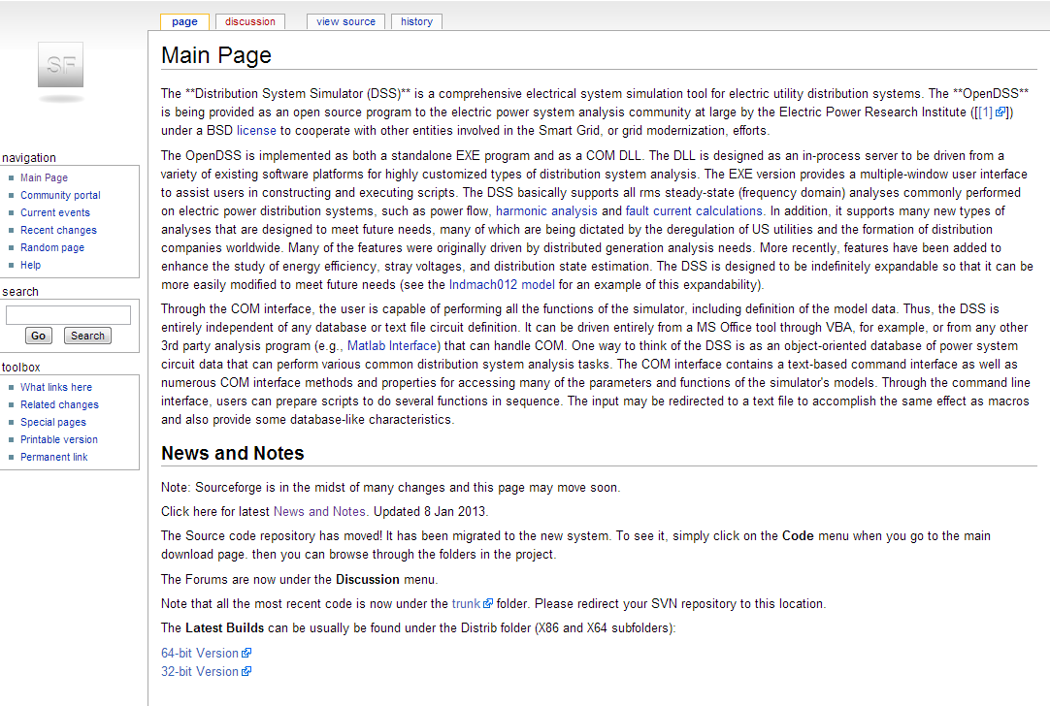
Wiki Home Page

Slide 46
Accessing the SourceForge.Net Source Code Repository with TortoiseSVN
Install a TortoiseSVN client from Tortoisesvn.net/downloads.
  64-bit for Windows 7 64-bit, or 32-bit
To Download all the files from SourceForge by:
1 - create a clean directory such as "c:\opendss"
2 - right-click on it and choose "SVN Checkout..." from the menu
3 - the repository URL is
    http://svn.code.sf.net/p/electricdss/code/trunk/
    (Change the checkout directory if it points somewhere other than what you want.)

Slide 47
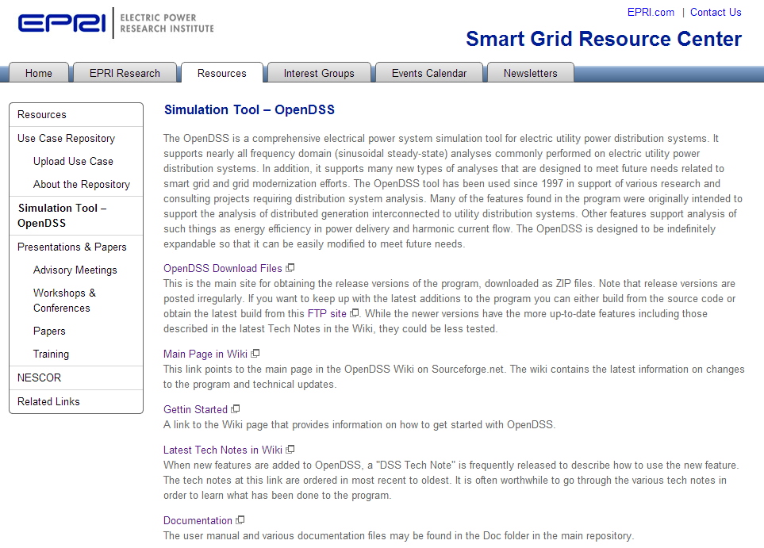
http://smartgrid.epri.com/SimulationTool.aspx

Slide 48
OpenDSS Program Installation

Slide 49
Installer for 7.6.2 Version
Main OpenDSS Link Page on EPRI Smart Grid Site
  http://smartgrid.epri.com/SimulationTool.aspx
The download files contain an installer
You can use the installer or install manually
The installer is not required to replace files after first installation
See the “ReadMe.Txt” file with the download

Slide 50
Program Files (as of January 2013)
For each of X86 and X64 versions:
  OpenDSS.EXE Standalone EXE
  OpenDSSEngine.DLL In-process COM server
  KLUSolve.DLL Sparse matrix solver
  DSSView.EXE is a separate program for processing graphics output

Slide 51
Installing
Use the Installer
  Or -
Copy these files to the directory (folder) of your choice
  Typically c:\OpenDSS -or- c:\Users\MyUserName\OpenDSS (Windows 7)
Note: Installing to Program Files may not work as desired due to a permissions issue with your computer

Slide 52
Registering the COM Server Manually
Registering occurs automatically when using the Installer
If you intend to drive OpenDSS from another program, you will need to register the COM server
    Some programs require this !!
    If you are sure you will only use OpenDSS.EXE, you can skip this step
      You can come back and do it at any time
In the command (cmd) window, change to the folder where you installed it and type:
  Regsvr32 OpenDSSEngine.DLL

Slide 53
Manually Registering the COM Server – Windows 7
Special instructions for Windows 7
  (and probably Windows Vista, too)
  See Q&A on the Wiki site
  http://sourceforge.net/apps/mediawiki/electricdss/index.php?title=How_Do_I_Register_the_COM_Server_DLL_on_Windows_7%3F
All Programs > Accessories
right-click on the Command Prompt and select Run as Administrator.
Then change to your OpenDSS folder and type in
  "regsvr32 OpenDSSEngine.DLL”

Slide 54
Registering the COM Server – Windows 7, version 2
Another Process for Windows 7
  per Andy Keane- UC Dublin
  1. Right click on the desktop and select new -> shortcut
  2. For location of item just type ‘cmd’
  3. This will create a new shortcut to a command prompt on your desktop
  4. Right click on the new shortcut and select ‘Properties’
  5. On the shortcut tab select ‘Advanced’
  6. Tick the ‘Run as Administrator’ box
  7. Press Apply/OK and that command prompt will always be run as administrator allowing the user to use regsvr32

Slide 55
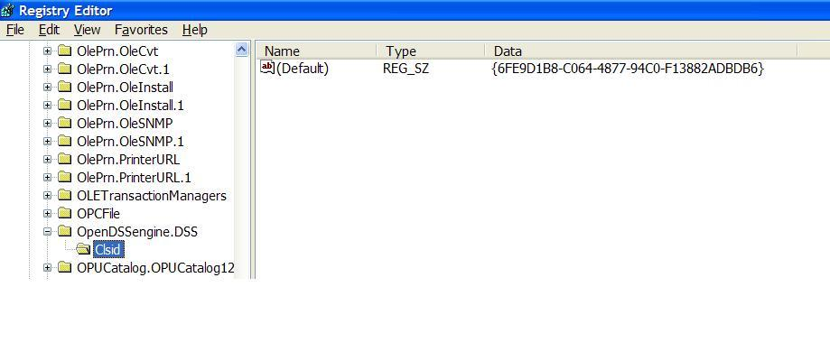
So What Did this Do?
Windows Registry Entry
GUID
The Server shows up as “OpenDSSEngine.DSS” in the Windows Registry
The OpenDSS is now available to any program on the computer
On Windows 7: 32-bit server is registered in WOW6432Node

Slide 56
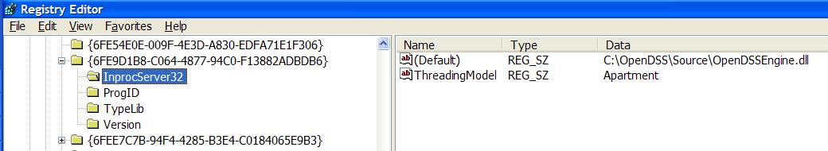
The GUID References the DLL File ….
If you look up the GUID in RegEdit
Points to OpenDSSEngine.DLL
(In-process server, Apartment Threading model)

Slide 57
32-bit Vs 64-bit
On Windows 7 you can register both versions
  They are in separate places in the registry
  You will probably need to register both
    MATLAB is often installed as 64-bit (x64)
    MS Office is most often installed as 32-bit (x86)
Windows 7 will run the proper version depending on the type of program invoking the DSSEngine.
  Magic!!

Slide 58
Questions So Far?

Slide 59
OpenDSS Architecture and
Circuit Modeling Basics
Description of basic circuit elements, bus models, etc.

Slide 60
DSS Structure
Scripts
Main Simulation Engine
COM Interface
User-Written DLLs
Scripts, Results

Slide 61
DSS Object Structure
DSS Executive
Commands
Options
Circuit
Solution
V
[Y]
I
PDElement
PCElement
Controls
Meters
General
Line
Transformer
Capacitor
Reactor
Load
Generator
Vsource
Isource
Storage
…
RegControl
CapControl
Relay
Reclose
Fuse
Monitor
EnergyMeter
Sensor
LineCode
LineGeometry
WireData
LoadShape
GrowthShape
Spectrum
TCCcurve
XfmrCode

Slide 62
DSS Class Structure
Instances of Objects of this class
Class
Object 1
Property Definitions
Property Values
Methods
Class Property Editor
Yprim
Collection Manager
States
Object n
Property Values
Methods
Yprim
States

Slide 63
Some of the Models Currently Implemented
POWER DELIVERY ELEMENTS
  CAPACITOR (Series and shunt capacitors; filter banks)
  LINE (All types of lines, cables)
  REACTOR (Series and shunt reactors)
  TRANSFORMER (multi-phase, multi-winding transformer models)
POWER CONVERSION ELEMENTS
  GENERATOR (General generator models)
  LOAD (General load models)
  PVSYSTEM (Solar PV system with panel and inverter)
  STORAGE (Generic storage element models)
CONTROL ELEMENTS
  CAPCONTROL (Capacitor bank control; various types)
  FUSE (Controls a switch, modeling fuse TCC behavior)
  GENDISPATCHER (A specialized controller for dispatching DG)
  RECLOSER (Controls a switch, modeling recloser behavior)
  REGCONTROL (Standard 32-step regulator/LTC control)
  RELAY (Controls a switch, modeling various relay behaviors)
  STORAGECONTROLLER (Implementation of AEP’s hub controller)
  SWTCONTROL (one way to control switches during simulations)
  VSOURCE (2-terminal multiphase voltage source, thevinen equivalent)

Slide 64
Models Currently Implemented, cont’d
GENERAL DATA
  CNDATA (Concentric neutral cable data)
  GROWTHSHAPE (Growth vs year)
  LINECODE (Line and cable impedances, matrices or symmetrical components)
  LINEGEOMETRY (Line geometry data)
  LINESPACING (spacing data for LINEGEOMETRY)
  LOADSHAPE (Load shape data)
  PRICESHAPE (Price shape data)
  SPECTRUM (Harmonic spectra)
  TCC_CURVE (TCC curves)
  TSDATA (Tape shield cable data)
  TSHAPE (Temperature shape data)
  WIREDATA (Wire parameters, GMR, etc.)
  XFMRCODE (Transformer type definitions)
  XYCURVE (Generic x-y curves)
METERS
  ENERGYMETER (Captures energy quantities and losses)
  MONITOR (Captures selected quantities at a point in the circuit)
  SENSOR (Simple monitor used for state estimation)
OTHER
  FAULT (1 or more faults can be placed anywhere in the circuit)
  ISOURCE (Multi-phase current source)
  VSOURCE (2-terminal multiphase voltage source, thevinen equivalent)

Slide 65
Input Data Requirements
The OpenDSS was designed for a research or consulting environment
  Input data is expected from a variety of sources.
The program can accept many common forms of data for distribution systems for planning analysis
  Impedances in a variety of forms
  Loading (kW, kvar, PF) and Generation
  Topology

Slide 66
Input Data Requirements
Input data is provided using OpenDSS Script
  Everything can be done via scripting
The OpenDSS scripting language is designed to require minimal translation from other formats of distribution data.
The program can accept more detailed data for lines, transformers, etc. than the standard data when they are available.

Slide 67
Examples of Advanced Types of Data
Harmonic spectra for harmonic analysis,
Various curves as a function of time for sequential time simulations:
Load shapes (e.g., AMI P, Q data),
Price shapes,
Temperature shapes,
Storage dispatch curves,
Growth curves.
Efficiency curves for PV inverters,
Voltage dependency exponents for loads,
Capacitor control settings,
Regulator control settings,
Machine data.

Slide 68
<<< BREAK >>>

Slide 69
Circuit Modeling Basics
Some things that might be a bit different than other power system analysis tools you may have used.

Slide 70
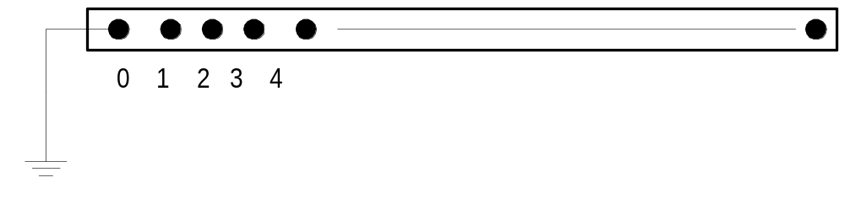
DSS Bus Model (Bus ≠ Node)
Nodes
Bus
Referring to Buses and Nodes (A Bus has 1 or more Nodes)
Bus1=BusName.1.2.3.0
(This is the default for a 3-phase circuit element)
Shorthand notation for taking the default
Bus1=BusName
Note: Sometimes this can bite you (e.g. – Transformers, or capacitors with ungrounded neutrals)

Slide 71
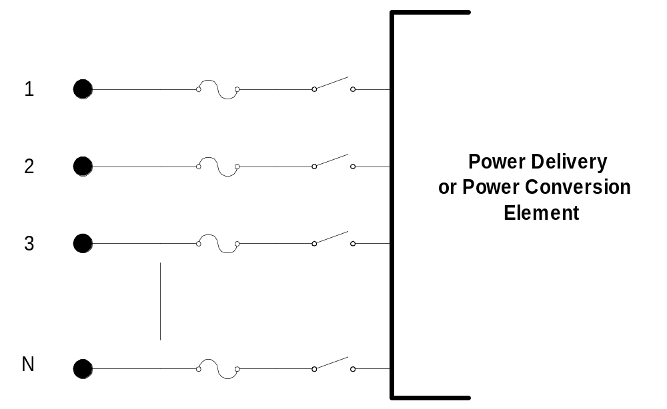
DSS Terminal Definition
Conductors
Circuit Elements have one or more Terminals with 1..N conductors.
Conductors connect to Nodes at a Bus
Each Terminal connects to one and only one Bus

Slide 72
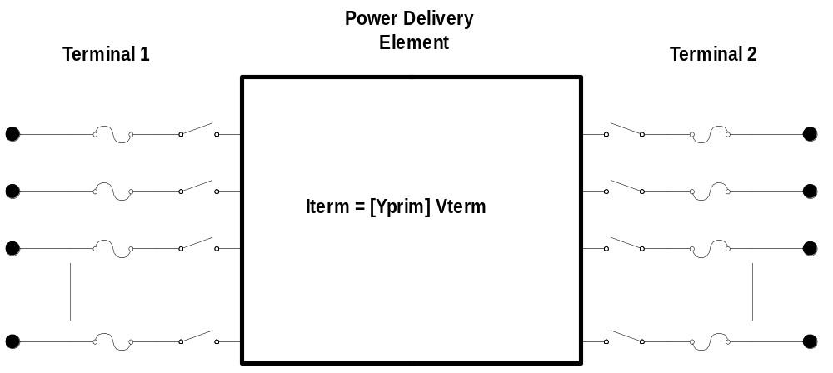
Power Delivery Elements
PD Elements are Generally Completely Described by [Yprim]

Slide 73
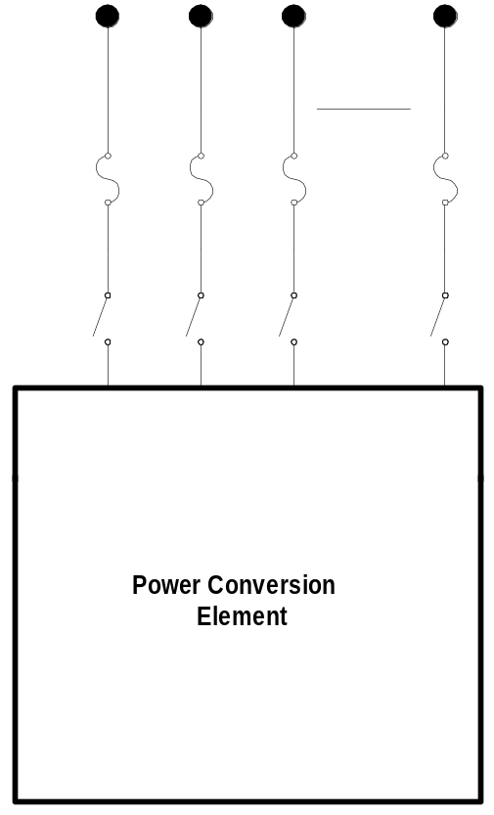

Power Conversion Elements
I_{Term}(t) = F(V_{Term}, [State], t)
Power Conversion (PC) elements are typically connected in “shunt” with the Power Delivery (PD) elements
PC Elements may be nonlinear
Described some function of V
  May be linear
  e.g., Vsource, Isource
May have more than one terminal, but typically one
  Load, generator, storage, etc.

Slide 74
Specifying Bus Connections
Shorthand (implicit)
  New Load.LOAD1 Bus1=LOADBUS
    Assumes standard 3-phase connection by default
LOADBUS
6
5
4
3
LOAD
2
1
0

Slide 75
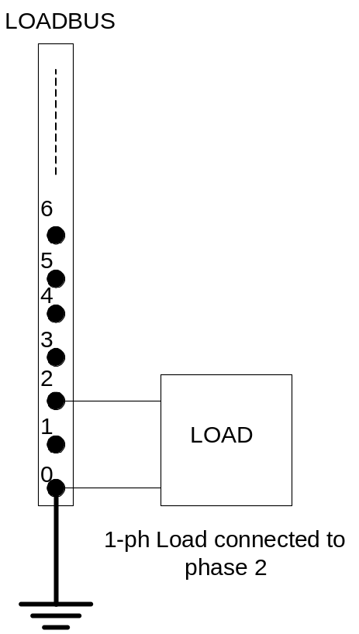
Specifying Bus Connections
Explicit
  New Load.LOAD1 Bus1=LOADBUS.1.2.3.0
      Explicitly defines which node
  New Load.1-PHASELOAD Phases=1 Bus1=LOADBUS.2.0
      Connects 1-phase load to
      Node 2 and ground
1-Phase Load Example

Slide 76
Specifying Bus Connections
Default Bus templates
    Node connections assumed if not explicitly declared
  Element declared Phases=1
    … LOADBUS.1.0.0.0.0.0.0.0.0.0. …
  Element declared Phases=2
    … LOADBUS.1.2.0.0.0.0.0.0.0.0. …
  Element declared Phases=3
    … LOADBUS.1.2.3.0.0.0.0.0.0.0. …

Slide 77
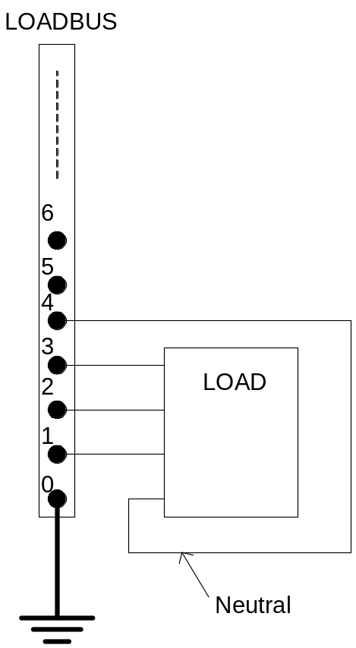
Specifying Bus Connections
  Ungrounded-Wye Specification
  Bus1=LOADBUS.1.2.3.4 (or some other unused Node number)
Voltage at this Node explicitly computed
(just like any other Node)

Slide 78
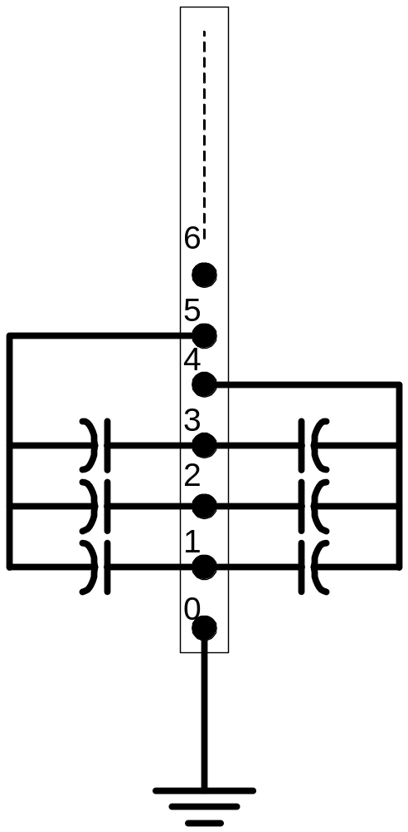
Possible Gotcha: Specifying Two Ungrounded-Wye Capacitors on Same Bus
MyBus
… Bus1=MyBus.1.2.3 Bus2=MyBus.5.5.5
Neutrals are not connected to each other in this specification!
… Bus1=MyBus Bus2=MyBus.4.4.4

Slide 79
Circuit Element Conductors are Connected to the Nodes of Buses
MyBus
3
2
1
0
. . . Bus2 = MyBus.2.1.3.0 . . .
. . . Bus1 = MyBus . . .
(take the default)
(Explicitly define connections)
DSS Convention: A Terminal can be connected to only one Bus.
You can have any number of Nodes at a bus.

Slide 80
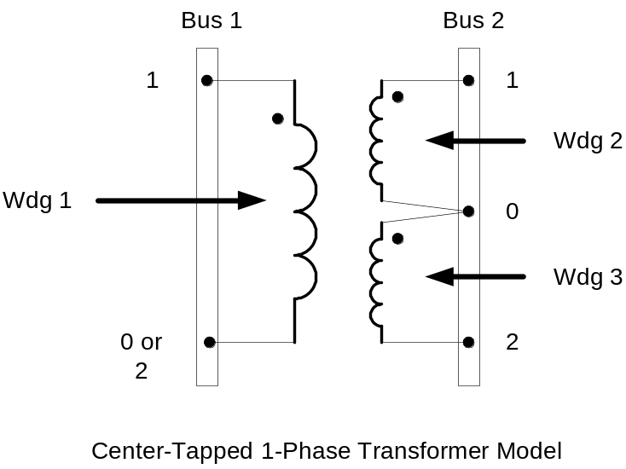
Example: Connections for 1-Phase Residential Transformer Used in North America
! Line-to-Neutral Connected 1-phase Center-tapped transformer
New Transformer.Example_1-ph phases=1 Windings=3
! Typical impedances for small transformer with interlaced secondaries
~ Xhl=2.04 Xht=2.04 Xlt=1.36 %noloadloss=.2
! Winding Definitions
~ wdg=1 Bus=Bus1.1.0 kV=7.2 kVA=25 %R=0.6 Conn=wye
~ wdg=2 Bus=Bus2.1.0 kV=0.12 kVA=25 %R=1.2 Conn=wye
~ Wdg=3 Bus=Bus2.0.2 kV=0.12 kVA=25 %R=1.2 Conn=wye
Note: You may use XfmrCode to define a library of transformer definitions that are used repeatedly (like LineCode for Line elements)

Slide 81
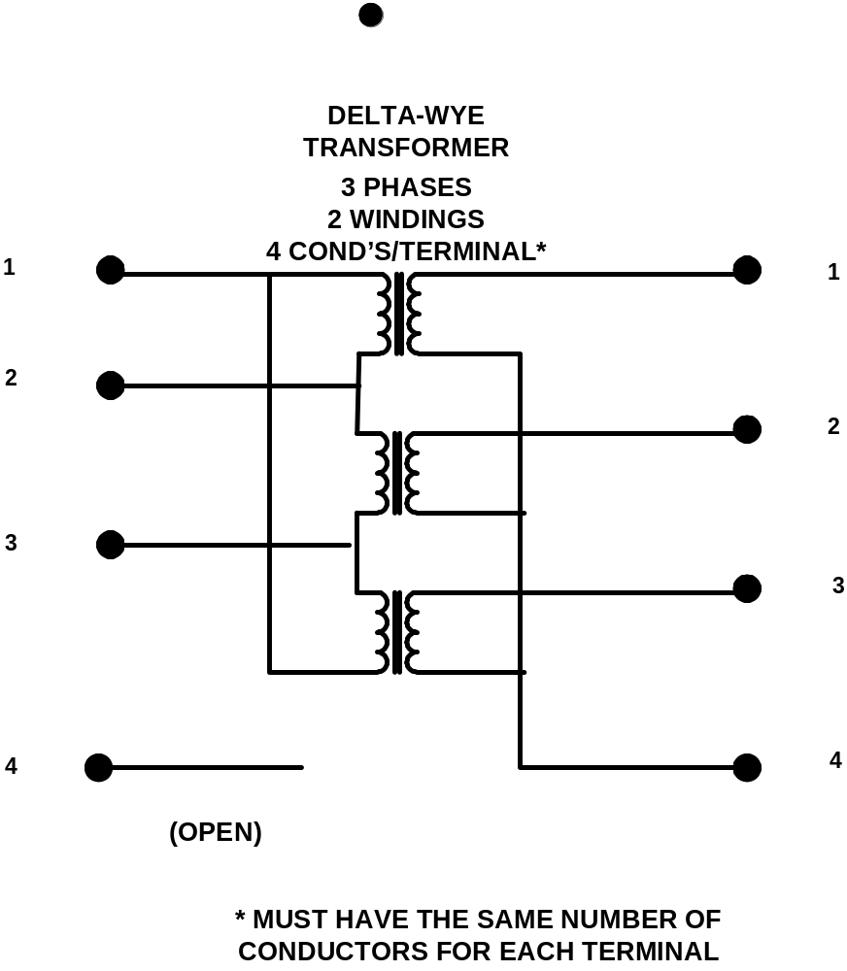
All Terminals of a Circuit Element Have Same Number of Conductors
3-Phase Transformer

Slide 82
Scripting Basics
Syntax and how to build circuit models.
Simple Model

Slide 83
Scripting
OpenDSS is a scriptable solution engine
Scripts
  Series of commands
  From text files
  From edit forms in OpenDSS.EXE
  From another program through COM interface
    e. g., This is how you would do looping
Scripts define circuits
Scripts control solution of circuits
Scripts specify output, etc.

Slide 84
Command Syntax
Command parm1, parm2 parm3 parm 4 ….
Parameters may be positional or named (tagged).
If named, an "=" sign is expected.
  Name=value (this is the named form)
  Value (value alone in positional form)
For example, the following two commands are equivalent:
  New Object="Line.First Line" Bus1=b1240 Bus2=32 LineCode=336ACSR, …
  New “Line.First Line”, b1240 32 336ACSR, …
Comma or white space

Slide 85
Delimiters
Array or string delimiter pairs: [ ] , { },( ),“ “,‘ ‘
Matrix row delimiter: |
Value delimiters: , (comma)
any white space (tab or space)
Class, Object, Bus, or Node delimiter: . (period)
Keyword / value separator: =
Continuation of previous line: ~ (More)
Comment line: //
In-line comment: !
Query a property: ?

Slide 86
Array and Matrix Parameters
Array
  kvs = [115, 6.6, 22]
  kvas=[20000 16000 16000]
Matrix
  (3x3 matrix)
    Xmatrix=[1.2 .3 .3 | .3 1.2 3 | .3 .3 1.2]
  (3x3 matrix – lower triangle)
    Xmatrix=[ 1.2 | .3 1.2 | .3 .3 1.2 ]

Slide 87
An Example

Slide 88
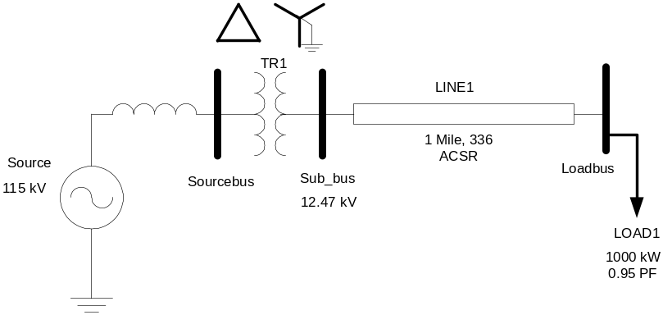
A Basic Script (Class Exercise)
New Circuit.Simple ! Creates voltage source (Vsource.Source)
Edit Vsource.Source BasekV=115 pu=1.05 ISC3=3000 ISC1=2500 !Define source V and Z
New Transformer.TR1 Buses=[SourceBus, Sub_Bus] Conns=[Delta Wye] kVs= [115 12.47]
~ kVAs=[20000 20000] XHL=10
New Linecode.336ACSR R1=0.058 X1=.1206 R0=.1784 X0=.4047 C1=3.4 C0=1.6 Units=kft
New Line.LINE1 Bus1=Sub_Bus Bus2=LoadBus Linecode=336ACSR Length=1 Units=Mi
New Load.LOAD1 Bus1=LoadBus kV=12.47 kW=1000 PF=.95
Solve
Show Voltages
Show Currents
Show Powers kVA elements

Slide 89
Circuit
New Circuit.Simple ! (Vsource.Source is active circuit element)
Edit Vsource.Source BasekV=115 pu=1.05 ISC3=3000 ISC1=2500
Vsource.Source
SourceBus
Source
115
kV
Short Circuit Impedance (a matrix) that yields 3000A 3-ph fault current and 2500A 1-ph fault current.
115 kV, 1.05 pu
One-Line Diagram
(default is 3-phase wye-grd source)

Slide 90
Vsource Element Note
Vsource is actually a Two-terminal Device
  2nd terminal defaults to connected to ground (0V)
  But you can connect it between any two buses
    Comes in handy sometimes
Conceptually a Thevinen equivalent
  Short circuit equivalent
  Actually converted to a Norton equivalent internally

Slide 91
20 MVA Substation Transformer
TR
SourceBus
1
Sub_Bus
Defining Using Arrays
Defining Winding by Winding
New Transformer.TR1 Phases=3 Windings=2
~ Buses=[SourceBus, Sub_Bus]
~ Conns=[Delta Wye]
~ kVs= [115 12.47]
~ kVAs=[20000 20000]
~ XHL=10
New Transformer.TR1 Phases=3 Windings=2 XHL=10
~ wdg=1 bus=SourceBus Conn=Delta kV=115 kVA=20000
~ wdg=2 bus= Sub_Bus Conn=wye kV=12.47 kVA=20000

Slide 92
The Line
Sub_Bus
LoadBus
LINE
1
1
Mile
,
336
New Linecode.336ACSR R1=0.058 X1=.1206 R0=.1784 X0=.4047 C1=3.4 C0=1.6 Units=kft
New Line.LINE1 Bus1=Sub_Bus Bus2=LoadBus Linecode=336ACSR Length=1 Units=Mi
Line objects may also be defined by Geometry or matrix properties.
(Rmatrix=… Xmatrix=… Cmatrix=…)

Slide 93
The Load
Loadbus
LOAD
1
1000
kW
0
.
95
PF
New Load.LOAD1 Bus1=LoadBus kV=12.47 kW=1000 PF=.95
For 3-phase loads, use L-L kV and total kW
For 1-phase loads, typically use L-N kV and total kW
unless L-L-connected; Then use L-L kV.

Slide 94
Solving and Showing Results Reports
  Solve
    Show summary (power flow summary)
  Show Voltages
  Show Currents
  Show Powers kVA elements
Also
  Export … (creates CSV files)
  Plot …

Slide 95
<<< BREAK >>>

Slide 96
Scripting for Larger Circuits
How to organize scripts for larger problems
Examination of how the IEEE 8500-Node Test Feeder model is organized
Robert F. Arritt

Slide 97
Scripting Large Circuits
For small circuits, often put all the scripts in one file
  Some IEEE test feeder examples are mostly in one file
When you have large amounts of data, a more disciplined approach is recommended using multiple files:
Redirect Command
  Redirects the input to another file
  Returns to home directory
Compile Command
  Same as Redirect except repositions home directory

Slide 98
Organizing Your Main Screen
OpenDSS.exe saves all windows on the main screen
  They appear where you left them when you shut down
  The next time you start up, you can resume your work
Values are saved in the Windows Registry
Come up with a way you are comfortable with

Slide 99
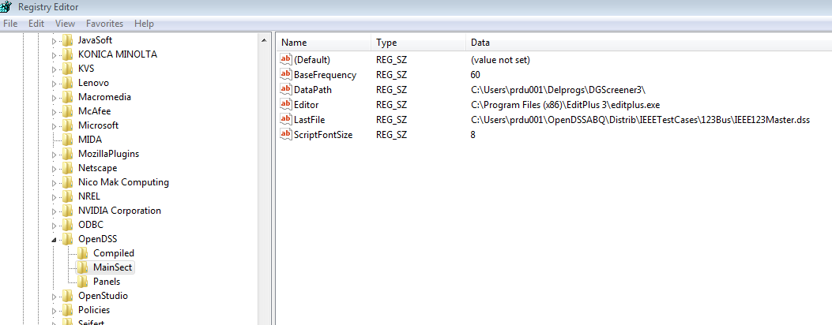
OpenDSS Registry Entries
Certain persistent values are saved to the Windows Registry upon exiting the program
Default Editor Setting

Slide 100
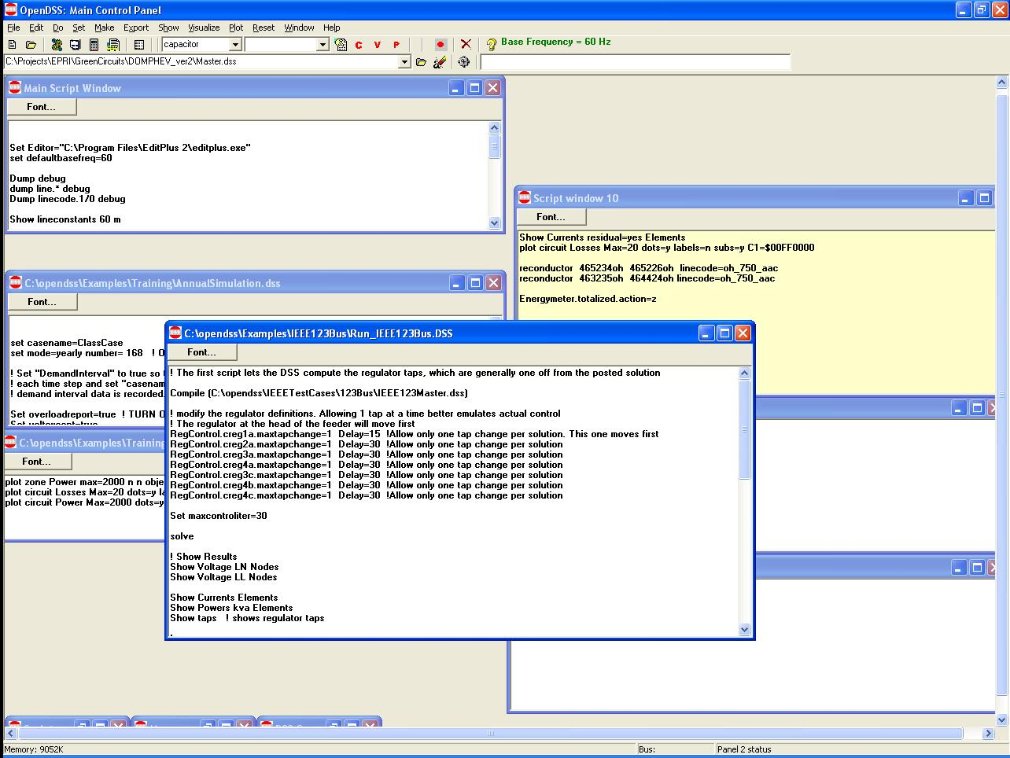
Organizing Your Main Screen
Main Script Window never goes away. Put some frequently-used commands here.
Annual Simulation Script
Misc. Scripts
Plotting Scripts
Project Run window

Slide 101
A Common Sense Structuring of Script Files
Run_The_Master.DSS
“Compile” the Master file from here
Master.DSS
LineCodes.DSS
WireData.DSS
LineGeometry.DSS
Libraries
Put a “Clear” in here
Spectrum.DSS
LoadShape.DSS
Transformers.DSS
Lines.DSS
Circuit
Definition
Make a separate folder for each circuit
Loads.DSS
Etc.

Slide 102
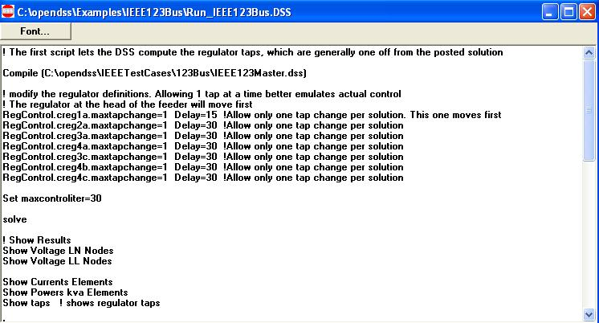
Organizing Run Scripts
Based on 123-bus Test Feeder
Compiles the Circuit Description
Override Some Property Settings
and/or
Define Some Additional Circuit Element
Change an option
Solve Snapshot Power Flow
Selected Results Display

Slide 103
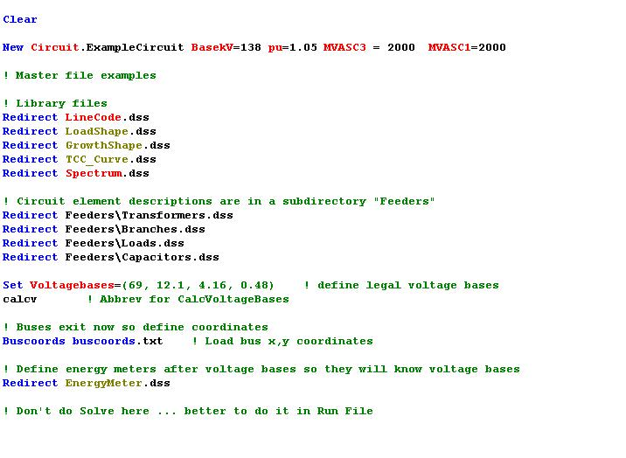
Organizing Your Master File
So Compile Doesn’t Fail
General Library Data
Circuit Elements for this Model
Let OpenDSS Define the Voltage Bases
(You can do this explicitly with SetkVBase command)

Slide 104
Example:
IEEE 8500-Node Test Feeder

Slide 105
Main Part of “Run” File
Compile base circuit description
Add an energymeter not in base description
Change an option
Solve
Compile (C:\DSSdata\IEEETest\8500Node\Master-unbal.dss)
! Put an Energymeter at the head of the feeder
New Energymeter.m1 Line.ln5815900-1 1
! Sometimes the solution takes more than the default 15 iterations
Set Maxiterations=20
Solve

Slide 106
The Master File
Clear
New Circuit.IEEE8500u
! Make the source stiff with small impedance
~ pu=1.05 r1=0 x1=0.001 r0=0 x0=0.001
Redirect LineCodes2.dss
Redirect Triplex_Linecodes.dss
Redirect Lines.dss
Redirect Transformers.dss
Redirect LoadXfmrs.dss ! Load Transformers
Redirect Triplex_Lines.dss
Redirect UnbalancedLoads.dss
Redirect Capacitors.dss
Redirect CapControls.dss
Redirect Regulators.dss
! Let DSS estimate the voltage bases
Set voltagebases=[115, 12.47, 0.48, 0.208]
Calcvoltagebases ! This also establishes the bus list
! Load in bus coordintes now that bus list is established
Buscoords Buscoords.dss

Slide 107
Exercise the 8500-Node Test Feeder …

Slide 108

Modeling
Examples

Slide 109
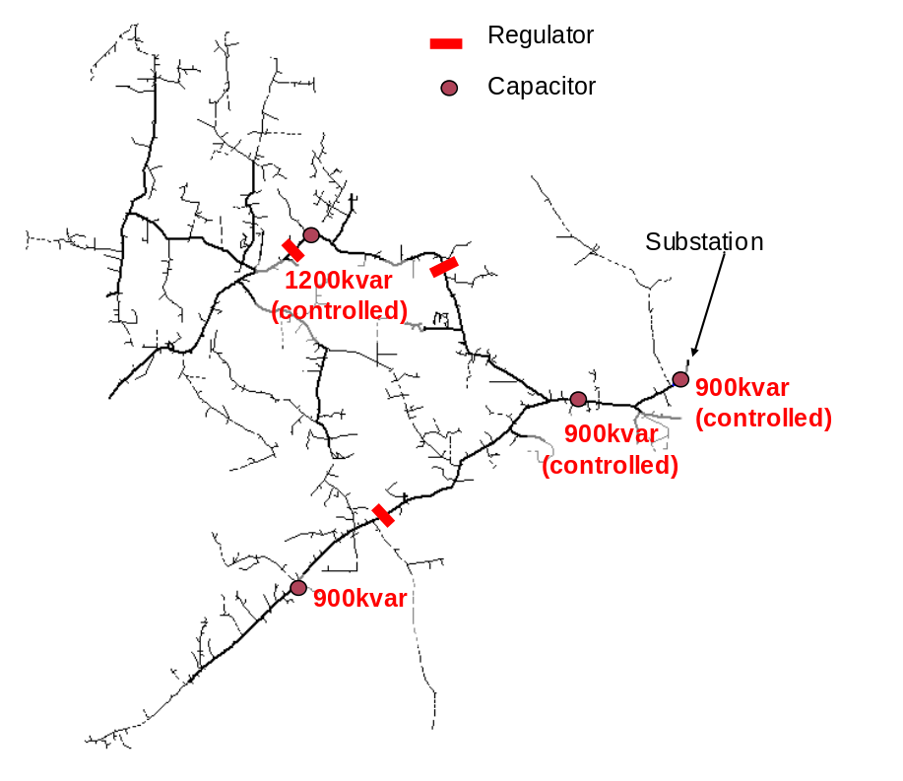
Per-Phase Capacitor Control
New Capacitor. CAPBank2 bus1=R20185 kv=12.47 kvar=900 conn=wye Three-Phase Capacitor
or
New Capacitor.CAPBank2A Bus1=R20185.1 kv=7.2 kvar=300 phases=1 conn=wye
New Capacitor.CAPBank2B Bus1=R20185.2 kv=7.2 kvar=300 phases=1 conn=wye
New Capacitor.CAPBank2C Bus1=R20185.3 kv=7.2 kvar=300 phases=1 conn=wye
Three Single-Phase Capacitors
Three single-phase capacitors defined.
The controlled capacitor banks monitor each phase separately and operates the respective capacitor on the same phase.
One-line of the IEEE 8500-Node Test Feeder Circuit

Slide 110
Per-Phase Capacitor Control, cont.
New CapControl.CAPBank2A_Ctrl Capacitor=CAPBank2A element=line.CAP_1A terminal=1 type=kvar ptratio=1 ctratio=1
~ ONsetting=150 OFFsetting=-225 VoltOverride=Y Vmin=7110 Vmax=7740 Delay=100 Delayoff=100
New CapControl.CAPBank2B_Ctrl Capacitor=CAPBank2B element=line.CAP_1B terminal=1 type=kvar ptratio=1 ctratio=1
~ ONsetting=150 OFFsetting=-225 VoltOverride=Y Vmin=7110 Vmax=7740 Delay=101 Delayoff=101
New CapControl.CAPBank2C_Ctrl Capacitor=CAPBank2C element=line.CAP_1C terminal=1 type=kvar ptratio=1 ctratio=1
~ ONsetting=150 OFFsetting=-225 VoltOverride=Y Vmin=7110 Vmax=7740 Delay=102 Delayoff=102
Three Independently Controlled Single-Phase Capacitors
The capacitor is controlled to switches ON when the reactive power flow in the line is 50% of the capacitor size and switches OFF when the flow is 75% of the capacitor size in the reverse direction.
Each controlled capacitor also includes voltage override where the capacitor turns ON at 0.9875pu and turns OFF at 1.075pu.
One-line of the IEEE 8500-Node Test Feeder Circuit

Slide 111
Capacitor-Control Timing
New CapControl.CAPBank2A_Ctrl Capacitor=CAPBank2A element=line.CAP_1A terminal=1 type=kvar ptratio=1 ctratio=1
~ ONsetting=150 OFFsetting=-225 VoltOverride=Y Vmin=7110 Vmax=7740 Delay=100 Delayoff=80
New CapControl.CAPBank1A_Ctrl Capacitor=CAPBank1A element=line.CAP_2A terminal=1 type=kvar ptratio=1 ctratio=1
~ONsetting=150 OFFsetting=-225 VoltOverride=Y Vmin=7110 Vmax=7740 Delay=90 Delayoff=90
New CapControl.CAPBank0A_Ctrl Capacitor=CAPBank0A element=line.CAP_3A terminal=1 type=kvar ptratio=1 ctratio=1
~ONsetting=200 OFFsetting=-300 VoltOverride=Y Vmin=7110 Vmax=7740 Delay=80 Delayoff=100
CAPBank0
Turned-ON FIRST
Turn-OFF LAST
CAPBank2
Turned-ON LAST
Turn-OFF FIRST
CAPBank1
Turned-ON MIDDLE
Turn-OFF MIDDLE
One-line of the IEEE 8500-Node Test Feeder Circuit

Slide 112
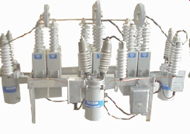
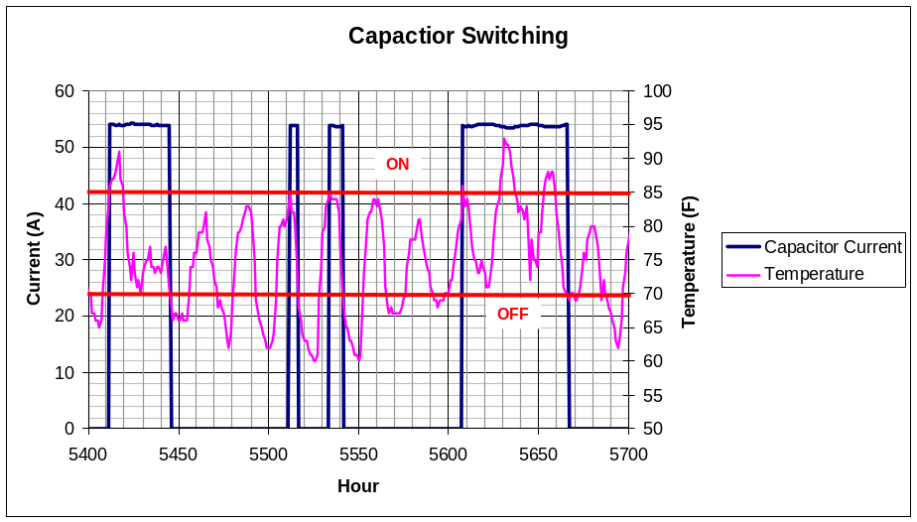
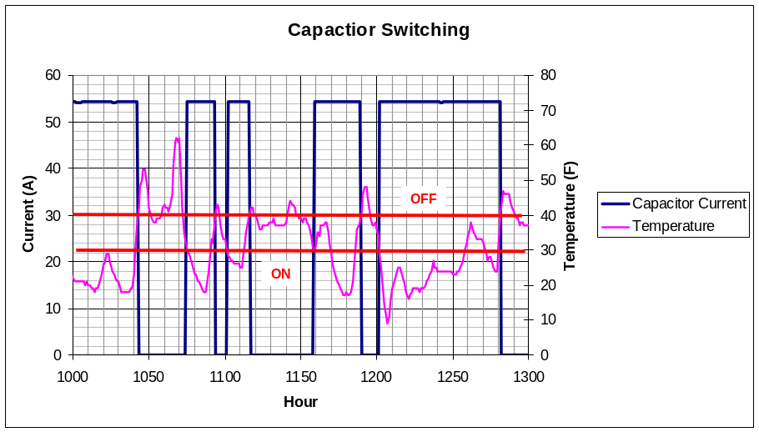
Capacitor Control – Multiple Control Methods
CapControl.JA-86271_Con_Temp_Summer.Enabled = no
CapControl.JA-86271_Con_Temp_Winter.Enabled = yes
Solve
Set number = 2951 !!!! Next 4 Months
CapControl.JA-86271_Con_Temp_Summer.Enabled = yes
CapControl.JA-86271_Con_Temp_Winter.Enabled = no
solve
set number = 2591 !!!! Next 4 Months
CapControl.JA-86271_Con_Temp_Summer.Enabled = no
CapControl.JA-86271_Con_Temp_Winter.Enabled = yes
solve
Enable and Disable Capacitor Control
Summer Switching (May 15 to September 15)
Non-Summer Switching (September 15 to May 15)

Slide 113
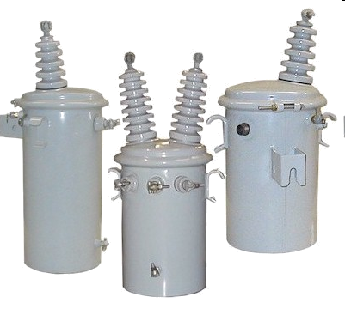
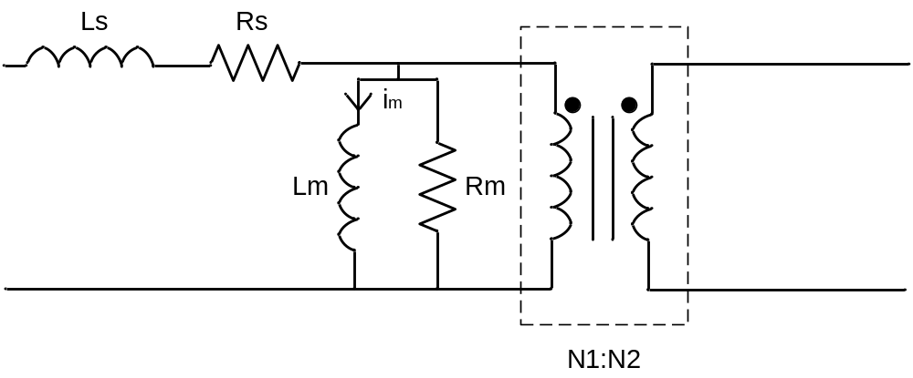
Modeling Transformers
Non-ideal transformer modeling
  Voltage Dependent (Core Loss,
  Magnetizing Current)
  Load Dependent (Leakage Reactance, Series Loss)
!DSS Script:
New Transformer.XX phases=1 wdg=1 bus=Y.1 kv=7.2 kVA=15 wdg=2 bus=Z.1
~ kv=0.24 kVA=15 XHL=2 %loadloss=0.9 %imag=0.5 %noloadloss=0.2

Slide 114
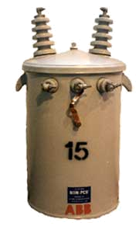
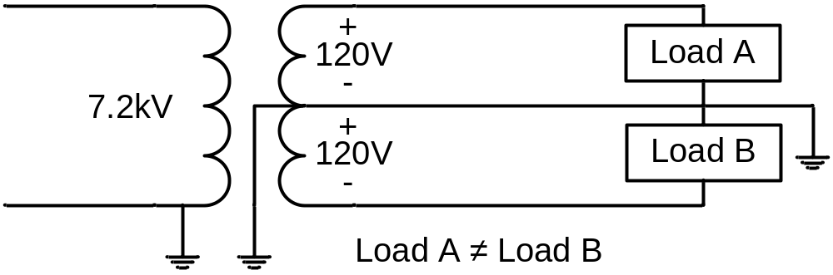
Modeling Split-Phase Transformers
OpenDSS allows for a split-phase transformer to be modeled.
!DSS Script:
New Transformer.D4D2SA phases=1 Windings=3
~Xhl=2.04 Xht=2.04 Xlt=1.36 %noloadloss=0.2
~wdg=1 bus=A.1 kv=7.2 kVA=15 %r=0.5
~wdg=2 bus=B.1.0 kv=0.12 %r=0.6 conn=delta
~wdg=3 bus=B.0.2 kv=0.12 %r=0.6 conn=delta
Note:
Xhl: reactance winding 1 to winding 2(H-L)
Xht: reactance winding 1 to winding 3(H-T)
Xlt: reactance winding 2 to winding 3(L-T)
Bus=A
Bus=B
1
1
0
Warning:
“%loadloss” overwrites “%r” for windings 1 and 2 only.
0
2

Slide 115
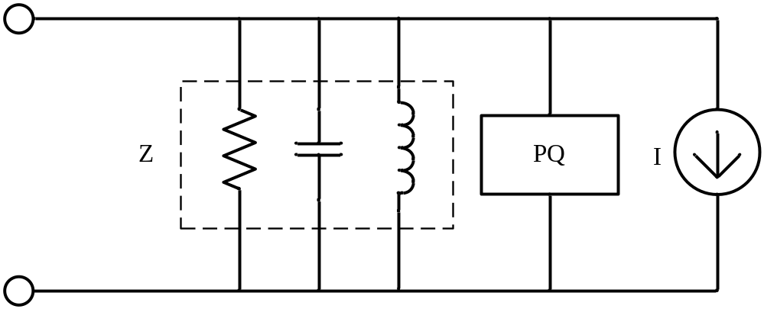
Load Modeling
Model 4 includes a voltage dependent element which allows for the study of voltage optimization.
!DSS Script:
New load.X_1 phases=1 bus1=1_sec_x.2 kV=0.24 xfkVA=50 pf=0.91 status=variable
~ model=4 CVRwatts=0.8 CVRvars=3 conn=wye yearly=LoadshapeB
CVRw factor = %∆P / %∆V
Where:
%∆P = Change in Power
%∆V = Change in Voltage
Approximate Equivalent Circuit

Slide 116


Voltage Regulation Modeling
!DSS Script:
New Transformer.VREG2_A phases=1 windings=2 buses=(regxfmr_190.1, 190.1) conns=(wye, wye) kvs=(7.2, 7.2)
~ kvas=(10000, 10000) xhl=0.001 %loadloss=.01 Wdg=2 Maxtap=1.1 Mintap=0.9 ppm=0
New Transformer.VREG2_B phases=1 windings=2 buses=(regxfmr_190.2, 190.2) conns=(wye, wye) kvs=(7.2, 7.2)
~ kvas=(10000, 10000) xhl=0.001 %loadloss=.01 Wdg=2 Maxtap=1.1 Mintap=0.9 ppm=0
New Transformer.VREG2_C phases=1 windings=2 buses=(regxfmr_190.3, 190.3) conns=(wye, wye) kvs=(7.2, 7.2)
~ kvas=(10000, 10000) xhl=0.001 %loadloss=.01 Wdg=2 Maxtap=1.1 Mintap=0.9 ppm=0
New RegControl.VREG2_A transformer=VREG2_A winding=2 vreg=125 ptratio=60 band=2
New RegControl.VREG2_B transformer=VREG2_B winding=2 vreg=125 ptratio=60 band=2
New RegControl.VREG2_C transformer=VREG2_C winding=2 vreg=125 ptratio=60 band=2

Slide 117


Voltage Regulation – Remote Monitoring
Remote regulating can be used in control voltage
Define “Bus= ” in RegControl to monitor remote bus.
This remote regulation can maintain voltage in areas of concern when CVR is implemented
Remote Regulating
Regulators
One-line of the IEEE 8500-Node Test Feeder Circuit

Slide 118
<<< BREAK >>>

Slide 119
OpenDSS COM Interface
Programming via the COM interface
Thomas E. McDermott

Slide 120
Two Implementations of OpenDSS
Stand-alone EXE
  32-bit
  64-bit
  Use this to develop text scripts to study problems
In-Process COM Server
  32-bit
  64-bit
  Use this to link OpenDSS to other programs
    Automate the program
    Execute complex algorithms

Slide 121
DSS Structure
Scripts
Main Simulation Engine
COM Interface
User-Written DLLs
Scripts, Results

Slide 122
OpenDSSEngine.DSS is Registered
Windows Registry Entry
GUID
The Server shows up as “OpenDSSEngine.DSS” in the Windows Registry
The OpenDSS is now available to any program on the computer

Slide 123
Linking Your Program to the COM Server
Examples of accessing the COM server in various languages
In MATLAB:
  DSSobj = actxserver(‘OpenDSSEngine.DSS’);
In VBA:
  Public DSSobj As OpenDSSEngine.DSS
  Set DSSobj = New OpenDSSEngine.DSS
In Dephi
  {Import Type Library}
  DSSObj := coDSS.Create;
In PYTHON:
  self.engine = win32com.client.Dispatch("OpenDSSEngine.DSS")

Slide 124
OpenDSS COM Interfaces
There are many interfaces supplied by the COM server
There is one registered In-Process COM interface:
  OpenDSSEngine.DSS
    The DSS interface is the one your program instantiates
    The DSS interface then creates all the others.
    This is for simplicity for users who are not necessarily familiar with COM programming

Slide 125
“Active objects” concept
.The interfaces generally act on the ACTIVE object
  Active circuit,
  Active circuit element,
  Active bus, etc.
The interfaces generally point to the active object
  To work with another object, change the active object
    There are methods for selecting objects
    You may also use script commands

Slide 126

DSS Interface
This is the main interface. It is instantiated upon loading OpenDSSEngine.DSS and then instantiates all other interfaces internally
Call the Start(0) method to initialize the DSS
DSS Class Functions (methods) and Properties

Slide 127
A Simple VBA Macro
(Class Exercise)
To run the IEEE 123-bus Test Feeder and plot the voltage profile

Slide 128
Option Explicit
Public MyOpenDSS As OpenDSSengine.DSS
Public MyText As OpenDSSengine.Text
Public MyCircuit As OpenDSSengine.Circuit
Public Sub MyMacro()
Set MyOpenDSS = New OpenDSSengine.DSS
MyOpenDSS.Start (0)
Set MyText = MyOpenDSS.Text
Set MyCircuit = MyOpenDSS.ActiveCircuit
MyText.Command = "Compile (C:\OpenDSS\IEEETestCases\123Bus\IEEE123Master.dss)"
MyText.Command = "New Energymeter.M1 element=Line.L115 terminal=1"
MyText.Command = "Solve"
Dim MyVoltages As Variant
Dim MyNames As Variant
Dim Mydistances As Variant
MyVoltages = MyCircuit.AllBusVmagPu
MyNames = MyCircuit.AllNodeNames
Mydistances = MyCircuit.AllNodeDistances
Dim i As Integer, irow As Integer
irow = 1
For i = LBound(MyVoltages) To UBound(MyVoltages)
ActiveSheet.Cells(irow, 1).Value = MyNames(i)
ActiveSheet.Cells(irow, 2).Value = Mydistances(i)
ActiveSheet.Cells(irow, 3).Value = MyVoltages(i)
irow = irow + 1
Next I
Set MyOpenDSS = Nothing
End Sub

Slide 129
Steps Require to Do This
Register OpenDSSEngine.DLL (32-bit)
Start Microsoft Excel
Type alt-F11 to open VBA editor
  Or Tools>Macro …
Select OpenDSS Engine under Tools>References
Insert>Module
Enter the VBA code into blank module
  Use correct path name for your computer
Execute the macro “MyMacro”

Slide 130

Resulting Chart in Excel

Slide 131
Branch Exchange Example
See
OpenDSS Wiki on SourceForge.Net
TechNote_Excel_VBA_Example

Slide 132

Loss Minimization – Branch Exchange
Branch Exchange
Loop Breaking
Branch & Bound
Heuristics
Optimization
  Genetic Alg.
  Simulated Annealing
  Ant Colony
  Et cetera

Slide 133
While Not done
r = iter + 1
ws.Cells(r, 10) = iter
ckt.Solution.Solve ‘ solve the current system
ThisLoss = ckt.Losses(0)
ws.Cells(r, 11) = ThisLoss ‘ write current losses, # loops, # isolated loads to sheet
ws.Cells(r, 12) = CStr(ckt.Topology.NumLoops) & " _ " & _
CStr(ckt.Topology.NumIsolatedLoads)
Vmax = 0# ‘ track the maximum voltage difference across any open switch
ToClose = ""
ToOpen = ""
LowBus = ""
c = 14 ‘ column number for output
i = swt.First ‘ check all SwtControls
While i > 0 ' find the open switch with biggest delta-V
… (Inner loop – next slide)
Wend
ws.Cells(r, 13) = CStr(Vmax)
done = True ' unless we found a switch pair to exchange
If Len(ToOpen) > 0 And Len(ToClose) > 0 Then ‘ found a switch pair to exchange
swt.name = ToClose ‘ do the switch close-open via SwtControl interface
swt.Action = dssActionClose
swt.name = ToOpen
swt.Action = dssActionOpen
done = False ' try again ‘ i.e., run solution again and look for the next exchange
End If
iter = r
' stop if too many iterations, system is non-radial, or losses go up
If iter > 10 Or ckt.Topology.NumIsolatedLoads > 0 Or ThisLoss > LastLoss Then
done = True ‘ met one of the three stopping criteria
End If
LastLoss = ThisLoss ‘ best loss total found so far
Wend

Slide 134
Inner Loop
  While i > 0 ' find the open switch with biggest delta-V
If swt.Action = dssActionOpen Then ‘ check only open switches
ws.Cells(r, c) = swt.name
Set elem = ckt.CktElements(swt.SwitchedObj)
Vdiff = Abs(elem.SeqVoltages(1) - elem.SeqVoltages(4)) ‘ V1 across switch
If Vdiff > Vmax Then ‘ if highest V1 difference so far…
LowBus = FindLowBus ‘ which side of open switch has lowest V?
topo.BusName = LowBus ‘ start from that bus in the topology
Set elem = ckt.ActiveCktElement
k = 1
While (Not elem.HasSwitchControl) And (k > 0) ‘ trace back from low bus to src
k = topo.BackwardBranch ‘ until we find a closed switch
Wend
If elem.HasSwitchControl Then ‘ if we found a switch to close…
Vmax = Vdiff ‘ keep this as the highest voltage difference found
ToClose = swt.name ‘ we will close this currently-open switch
ToOpen = Mid(elem.Controller, 12) ‘ and open the switch from back-trace
End If
End If
c = c + 1
End If
i = swt.Next
Wend

Slide 135
<<< BREAK >>>

Slide 136
Custom Simulations
Co-simulation Example

Slide 137

The Problem (A Hypothetical Case)
PV Location (2.5 MW)
Voltage regulator
Clusters of
Storage Units
Ref: EPRI/AEP Smart Grid Demo
Community Energy Storage Concept

Slide 138


Solar Ramp Rate Issue
Assumed Solar Ramping Function
Result

Slide 139
The Question
Can you dispatch the 84 CES units fast enough to compensate for the sudden loss of PV generation on a “Cloud Transient” ?
Why it might not work:
  Communications latency
  CES not in right location or insufficient capacity
Calls for a “Hybrid” simulation
  Communications network (NS2)
  Distribution network (OpenDSS)

Slide 140

How We Did It

Slide 141
OpenDSS Script (Snippet)
Set sec=20
Solve ! Init steady state at t=20
Sample
! Start the ramp down at 1 sec
Set sec=21
Generator.PV1.kW=(2500 250 -) ! Decrement 10%
Solve
Sample
Set sec=22
Generator.PV1.kW=(2500 500 -) ! Decrement another 10%
Solve
Sample
Set sec = 22.020834372 ! Unit 1 message arrives
storage.jo0235001304.state=discharging %discharge=11.9
Solve
Sample
Set sec = 22.022028115 ! Unit 2 message arrives
storage.jo0235000257.state=discharging %discharge=11.9
Solve
Sample
Etc.

Slide 142


Results (for down ramp only)
Comm Simulation

Slide 143
Comm and Power Co-simulation
New and active research area
Working to more tightly link ns-2 and OpenDSS
  Or other comm simulators
Communications latency is an important issue with Smart Grid
  Power engineers tend to assume communications will happen
  But there are limits

Slide 144
Custom Simulation Scripting in
Snapshot Mode
This is the default solution mode
Attempts one solution for each “solve”
Solves the circuit “as is”
If you want something done, you have to specifically tell it
  Set Load and Generator kW, etc.
    Load.MyLoad.kW=125
    Loadshapes are not used in this mode!
  Sample Monitors and meters
    Solve
    Sample

Slide 145
Custom Simulation Scripting in
“Time” Mode
Similar to Snapshot mode EXCEPT:
  Loads, Generators can follow a selected Loadshape
    Duty, Daily, or Yearly
  Monitors are automatically sampled
    But not Energymeters; do that explicitly if desired
  Time is automatically incremented AFTER solve

Slide 146
Snapshot Mode Scripting Example
Set Gen kW explicitly each time step
! Start the ramp down at 1 sec
Set sec=1
Generator.PV1.kW=(2500 250 -)
Solve
Sample
Set sec=2
Generator.PV1.kW=(2500 500 -)
Solve
Sample
Set sec = 2.020834372 ! Unit 1
storage.jo0235001304.state=discharging %discharge=11.9
Solve
Sample
Set sec = 2.022028115 ! Unit 2
storage.jo0235000257.state=discharging %discharge=11.9
Solve
Sample
Set sec = 2.023158858 ! Unit 3
storage.jo0235000265.state=discharging %discharge=11.9
Solve
Sample
Set sec = 2.024604602 ! Unit 4
storage.jo0235000268_1.state=discharging %discharge=11.9
Solve
Sample
Set sec = 2.025738325 ! Unit 5
storage.jo0235000268_2.dispmode=discharging %discharge=11.9
Solve
Sample
Etc.
Solve and Sample explicitly at each step
Set each Storage unit discharge rate explicitly each time step
(time is used for recording purposes only)

Slide 147
Time Mode Scripting Example
All Loads, Generators will follow assigned Duty cycle loadshape
! Start the ramp down at 1 sec
Set mode=time loadshapeclass=duty
set stepsize=1s
Solve ! Base case t=0
Solve ! t=t+1 = 2
Solve ! t=2 second solution; t=t+1 = 3
Set sec = 2.020834372 ! Unit 1 (reset t)
storage.jo0235001304.state=discharging %discharge=11.9
Solve
Set sec = 2.022028115 ! Unit 2
storage.jo0235000257.state=discharging %discharge=11.9
Solve
Set sec = 2.023158858 ! Unit 3
storage.jo0235000265.state=discharging %discharge=11.9
Solve
Set sec = 2.024604602 ! Unit 4
storage.jo0235000268_1.state=discharging %discharge=11.9
Solve
Set sec = 2.025738325 ! Unit 5
storage.jo0235000268_2.dispmode=discharging %discharge=11.9
Solve
Etc.
Set sec=3
Solve ! t=3 solution; t=t+1 = 4
….

Slide 148

Custom Simulation Scripting:
Rolling Your Own Solution Algorithm
These commands allow step-by-step control of the solution process

Slide 149
Custom Simulation Scripting: Rolling Your Own Solution Algorithm
The basic Snapshot solution process:
  Initialize Snapshot (_InitSnap)
  Repeat until converged:
    Solve Circuit (_SolveNoControl)
    Sample control devices (_SampleControls)
    Do control actions, if any (_DoControlActions)
You may wish, for example, to interject custom control actions after the _SolveNoControl step

Slide 150
Co-simulation and OpenDSS
Simulation of power system and communications networks simultaneously
An important area of smart grid research
  Will messages be able to get to targets in time to perform Smart Grid functions?
  What will be the effect of communications latency?
Much work needs to be done developing appropriate tools

Slide 151
Custom Simulation Scripting, cont’d
Via COM interface
  Whatever you want (if you can write code)
See Examples Folder on Sourceforge site
  Excel: SampleDSSDriver.xls
  Matlab:
    VoltageProfileExample.m
    DSSMonteCarlo.m

Slide 152
For More Information …
See OpenDSS Custom Scripting.Doc
  (Sourceforge site, “Doc” Folder)

Slide 153
COM Interface
Continued..
More Details on Accessing the COM Interface from VBA

Slide 154
Instantiate the DSS Interface and Attempt Start
Public Sub StartDSS()
' Create a new instance of the DSS
Set DSSobj = New OpenDSSengine.DSS
' Start the DSS
If Not DSSobj.Start(0) Then
MsgBox "DSS Failed to Start"
Else
MsgBox "DSS Started successfully“
' Assign a variable to the Text interface for easier access
Set DSSText = DSSobj.Text
End If
End Sub

Slide 155

COM Interface
Interfaces as Exposed by VBA Object Browser in MS Excel
Text interface is simplest
Text has two Properties

Slide 156
Assign a Variable to the Text Interface
Public Sub StartDSS()
' Create a new instance of the DSS
Set DSSobj = New OpenDSSengine.DSS
' Start the DSS
If Not DSSobj.Start(0) Then
MsgBox "DSS Failed to Start"
Else
MsgBox "DSS Started successfully“
' Assign a variable to the Text interface for easier access
Set DSSText = DSSobj.Text
End If
End Sub

Slide 157
Now Use the Text Interface …
You can issue any of the DSS script commands from the Text interface
‘ Always a good idea to clear the DSS when loading a new circuit
DSSText.Command = "clear"
' Compile the script in the file listed under "fname" cell on the main form
DSSText.Command = "compile " + fname
‘ Set regulator tap change limits for IEEE 123 bus test case
With DSSText
.Command = "RegControl.creg1a.maxtapchange=1 Delay=15 !Allow only one tap change per solution. This one moves first"
.Command = "RegControl.creg2a.maxtapchange=1 Delay=30 !Allow only one tap change per solution"
.Command = "RegControl.creg3a.maxtapchange=1 Delay=30 !Allow only one tap change per solution"
.Command = "RegControl.creg4a.maxtapchange=1 Delay=30 !Allow only one tap change per solution"
.Command = "RegControl.creg3c.maxtapchange=1 Delay=30 !Allow only one tap change per solution"
.Command = "RegControl.creg4b.maxtapchange=1 Delay=30 !Allow only one tap change per solution"
.Command = "RegControl.creg4c.maxtapchange=1 Delay=30 !Allow only one tap change per solution"
.Command = "Set MaxControlIter=30"
End With

Slide 158
Result Property
The Result property is a Read Only property that contains any result messages the most recent command may have issued.
  Error messages
  Requested values
‘ Example: Query line length
DSSText.Command = “? Line.L1.Length”
S = DSSText.Result ‘ Get the answer
MsgBox S ‘ Display the answer

Slide 159

Circuit Interface
This interface is used to
Get many of the results for the most recent solution of the circuit
Select individual circuit elements (in a variety of ways)
Select the active bus
Enable/Disable circuit elements

Slide 160
Circuit Interface
Since the Circuit interface is used often, it is recommended that a special variable be assigned to it:
Public DSSCircuit As OpenDSSengine.Circuit
…
DSSText.Command = “Compile xxxx.dss”
Set DSSCircuit = DSSobj.ActiveCircuit
DSSCircuit.Solution.Solve
… ‘ Retrieving array quantities into variants
V = DSSCircuit.AllBusVmagPu
VL =DSSCircuit.AllElementLosses

Slide 161

Solution Interface
The Solution Interface is used to
Execute a solution
Set the solution mode
Set solution parameters (iterations,
control iterations, etc.)
Set the time and time step size

Slide 162
Solution Interface
Assuming the existence of a DSSCircuit variable referencing the Circuit interface
Set DSSSolution = DSSCircuit.Solution
With DSSSolution
…
.LoadModel=dssAdmittance
.dblHour = 750.75
.solve
End With
Use the With statement in VBA to simplify coding

Slide 163

CktElement Interface
This interface provides specific values of the Active Circuit Element
Some values are returned as variant arrays
V = DSSCircuit.ActiveElement.Powers
V = DSSCircuit.ActiveElement.seqCurrents
V = DSSCircuit.ActiveElement.Yprim
Other values are scalars
Name = DSSCircuit.ActiveElement.Name
Nph = DSSCircuit.ActiveElement.NumPhases

Slide 164

Properties Interface
This interface gives access to a String value of each public property of the active element
“Val” is a read/write property

Slide 165
Properties Interface
With DSSCircuit.ActiveElement
  ‘ Get all the property names
  VS = .AllPropertyNames
  ‘ Get a property value by numeric index
  V = .Properties(2).Val
  ‘ Get same property value by name (VS is 0 based)
  V = .Properties(VS(1)).Val
  ‘ Set Property Value by Name
  DSSCircuit.SetActiveElement(“Line.L1”)
  .Properties(‘R1’).Val = “.068”
End With
The last two statements are equivalent to:
DSSText.Command = “Line.L1.R1=.068”

Slide 166

Lines Interface
This interface is provided to iterate through all the lines in the circuit and change the most common properties of Lines.

Slide 167
Example: Setting all LineCodes to a Value
Set DSSLines = DSSCircuit.Lines
. . .
iL = DSSLines.First ‘sets active
Do While iL>0
DSSLines.LineCode = MyNewLineCode
iL = DSSLines.Next ‘ get next line
Loop

Slide 168
VBA Example
Option Explicit
Public DSSobj As OpenDSSengine.DSS
Public DSSText As OpenDSSengine.Text
Public DSSCircuit As OpenDSSengine.Circuit
Public Sub StartDSS()
' Create a new instance of the DSS
Set DSSobj = New OpenDSSengine.DSS
' Assign a variable to the Text interface for easier access
Set DSSText = DSSobj.Text
' Start the DSS
If Not DSSobj.Start(0) Then MsgBox "DSS Failed to Start"
End Sub
Define some public variables that are used throughout the project
This routine instantiates the DSS and starts it. It is also a good idea at this time to assign the text interface variable.

Slide 169
VBA Example
Public Sub LoadCircuit(fname As String)
' Always a good idea to clear the DSS when loading a new circuit
DSSText.Command = "clear"
' Compile the script in the file listed under "fname" cell on the main form
DSSText.Command = "compile " + fname
' The Compile command sets the current directory the that of the file
' Thats where all the result files will end up.
' Assign a variable to the Circuit interface for easier access
Set DSSCircuit = DSSobj.ActiveCircuit
End Sub
This subroutine loads the circuit from the base script files using the Compile command through the Text interface. “fname” is a string contains the name of the master file.
There is an active circuit now, so assign the DSSCircuit variable.

Slide 170
VBA Example
Public Sub LoadSeqVoltages()
' This Sub loads the sequence voltages onto Sheet1 starting in Row 2
Dim DSSBus As OpenDSSengine.Bus
Dim iRow As Long, iCol As Long, i As Long, j As Long
Dim V As Variant
Dim WorkingSheet As Worksheet
Set WorkingSheet = Sheet1 'set to Sheet1 (target sheet)
iRow = 2
For i = 1 To DSSCircuit.NumBuses ' Cycle through all buses
Set DSSBus = DSSCircuit.Buses(i) ' Set ith bus active
' Bus name goes into Column 1
WorkingSheet.Cells(iRow, 1).Value = DSSCircuit.ActiveBus.Name
' Load sequence voltage magnitudes of active bus into variant array
V = DSSBus.SeqVoltages
' Put the variant array values into Cells
' Use Lbound and UBound because you don't know the actual range
iCol = 2
For j = LBound(V) To UBound(V)
WorkingSheet.Cells(iRow, iCol).Value = V(j)
iCol = iCol + 1
Next j
iRow = iRow + 1
Next i
End Sub
This Sub puts the sequence voltage onto a spreadsheet
Define a variable for the Bus interface
Define a variant to pick up the arrays
Cycle through all the buses
Get the bus name
Get the voltages into the variant array
Put them on the spreadsheet

Slide 171
Running from MATLAB

Slide 172
Running OpenDSS From Matlab
Starting the DSS
%Start up the DSS
[DSSStartOK, DSSObj, DSSText] = DSSStartup;
function [Start,Obj,Text] = DSSStartup
% Function for starting up the DSS
%
%instantiate the DSS Object
Obj = actxserver('OpenDSSEngine.DSS');
%
%Start the DSS. Only needs to be executed the first time w/in a
%Matlab session
Start = Obj.Start(0);
% Define the text interface to return
Text = Obj.Text;

Slide 173
Using the DSS through the Text Interface from Matlab (harmonics example)
%Compile the DSS circuit script
DSSText.Command = 'compile master.dss';
% get an interface to the active circuit called "DSSCircuit"
DSSCircuit = DSSObj.ActiveCircuit;
%Determine which connection type for the source and call
%appropriate DSS file
switch XFMRType
case 1
DSSText.Command = 'redirect directconnectsource.DSS';
case 2
DSSText.Command = 'redirect deltadelta.DSS';
case 3
DSSText.Command = 'redirect deltawye.DSS';
otherwise
disp('Unknown source Connection Type')
end
%Set the system frequency and vsource frequency for harmonic requested
DSSText.Command = ['set frequency=(' num2str(Freq) ' 60 *)'];
DSSText.Command = ['vsource.source.frequency=(' num2str(Freq) ' 60 *)'];

Slide 174
Using the DSS through the Text Interface from Matlab (harmonics example) (cont’d)
% Vary the parameters according to a random distribution
% If more parameters need to be varied, just add them to the below
% list. Set ParamNum to total number of parameters varied
ParamNum = 6; %ParamNum used for sorting/plotting
for Case_Count = 1:Max_Cases
%Create index in the OutputData matrix to keep the cases in order
OutputData(Case_Count,1) = Case_Count;
% Generate random new coordinates for each conductor
[x1 y1 x2 y2 x3 y3 geomean] = RandomGeometry(8,0.75,30);
(... etc. etc. )
%define a new line geometry with random spacing
DSSText.Command = ['New LineGeometry.OHMOD nconds=3 nphases=3 cond=1 wire=acsr336 x=' num2str(x1) ' ' num2str(y1) ' units=ft cond=2 wire=acsr336 x=' num2str(x2) ' ' num2str(y2) ' units=ft cond=3 wire=acsr336 x=' num2str(x3) ' ' num2str(y3) ' units=ft'];
%Solve the circuit
DSSText.Command = 'solve';
(etc. etc.)

Slide 175
Loadshapes and Smart Grid Simulation
How to use the OpenDSS Loadshape capability and simulate various time-series phenomena related to Smart Grid simulations.

Slide 176
Loadshapes
Key feature of OpenDSS
Sequential time simulation is required for many Smart Grid analyses
Basic time-varying modes that use Loadshape objects
  Daily (nominally 24 h, 1 h steps)
  Yearly (nominally 8760 h, 1 h steps)
  Dutycycle (nominal step size 1 s .. 5 m)
    (used for wind and solar)
Learning to work with Loadshapes is essential skill for OpenDSS users

Slide 177

Example Loadshape for Wind Turbine Output
Watts
Vars

Slide 178

Example Loadshapes Provided in Examples Folder

Slide 179
How to Define
Clear
! Example scripts for loading and plotting loadshapes out of the loadshape library
! You have to have a circuit defined to load in loadshapes.
New Circuit.LoadshapeExamples
! directly ...
New "LoadShape.LoadShape1a" npts=8760 interval=1.0 mult=(File=LoadShape1.csv)
Plot Loadshape Object=Loadshape1a ! execute this to prove you got it
! or using Redirect
Redirect Loadshape1.DSS ! Load in Loadshape 1
Plot Loadshape Object=Loadshape1

Slide 180

Example Yearly LoadShape

Slide 181
Loadshape Interpolation
The OpenDSS LOADSHAPE class uses two different types of interpolation depending on it is defined
Fixed interval data.
  Default. INTERVAL property defaults to 1 hour.
  You can set it to another value or to 0.
    The SINTERVAL and MINTERVAL properties facilitate defining intervals in second or minutes.
  INTERVAL > 0: fixed interval data
    CSV files --one numeric value per line.
    Interpolation algorithm assumes the value REMAINS CONSTANT over the entire interval
    The HOUR array property is ignored

Slide 182
Loadshape Interpolation, Cont’d
For LINEAR INTERPOLATION between the points, define INTERVAL=0.
  Then both the time and multiplier values for the loadshape using the HOUR, MULT, and QMULT array properties.
Alternatively, you may use the CSVFILE, DBLFILE, or SNGFILE properties.
  Enter both the time in hours and the multiplier values.
    A CSV file would have two values per line separated by a comma or whitespace.
The variable interval interpolation could be a little bit slower than the fixed interval data because there is more work to do to compute the factor.

Slide 183
Importing Packed Binary Files
For simulations, such as AMI, required large volumes of Loadshapes to be imported, using packed binary files can save time
Standard CSV or TXT file
  Mult=[file=myfile.txt]
File of doubles
  Mult=[dblfile=myfile.dbl]
File of singles
  Mult=[sngfile=myfile.sng]

Slide 184
Recent (2011) Enhancements to Defining Array Properties Using CSV files
Syntax:
  mult=[File=myMultiColumnFile.CSV, Column=n, Header=Yes/No]
Allows use of multicolumn CSV files with a single header row.
Example:
New Loadshape.Ramp2 npts=4000 sInterval=1 mult=(file=MultiChannelTest.csv, column=3, header=yes)
  Imports the 3rd column from the file, skipping the header row

Slide 185
Intrinsic Simulation Modes
Discussion of the various solution modes built into the OpenDSS

Slide 186
Built-in Solution Modes
Snapshot (static) Power Flow
Direct (non-iterative)
Daily mode (default: 24 1-hr increments)
Yearly mode (default 8760 1-hr increments)
Duty cycle (1 to 5s increments)
Dynamics (electromechanical transients)
Fault study
Monte carlo fault study
Harmonic
Custom user-defined solutions

Slide 187
Snapshot Mode
This is the default solution mode after creating a new circuit model
The basic power flow solution mode for the OpenDSS
Performs a single solution each time Solve is issued
Control mode defaults to “Static”
Defaults to iterative power flow solution
  Load model is “Powerflow”

Slide 188
Direct Mode
Performs a non-iterative solution of the present system admittance equation
Loads and Generators represented by constant impedance
  Value in their Norton equivalents
This is a useful mode when convergence is difficult, but needed to perform Harmonic, Dynamic, or Faultstudy mode solution.
  Will nearly always give a reasonable starting point for these solution modes

Slide 189
Daily Mode
Defaults
  Stepsize = 1.0 h
  Controlmode = static
  Number = 24
Designed for simulations of a load profile for one day for distribution planning studies, losses, other energy studies
Time step of 0.25 .. 1.0 h typically
One or more days (change number)
Set the Daily= property of Load and Generator to follow a loadshape
Similar functionality to Yearly mode

Slide 190
Yearly Mode
Defaults
  Stepsize = 1.0 h
  Controlmode = static
  Number = 8760
Designed for annual simulations for distribution planning studies, losses, other energy studies
Time step of 0.25 .. 1.0 h typically
All or part of year
Set the Yearly= property of Load and Generator to follow a loadshape

Slide 191
DutyCycle Mode
Defaults
  Stepsize = 1.0 s
  Controlmode = time
  Number = 100
Designed for simulations of wind turbine output, solar PV output, stone crushers, and other impulse loads
Time step of 1 – 10 s
Duration of a few minutes up to 1 day
Set the Duty= property of Load and Generator to follow a loadshape

Slide 192
Dynamics Mode
Defaults
  Stepsize = 0.001 s
  Controlmode = time
  Number = 100
Electromagnetic transients simulations
Generator state variables integrated
  Predictor-corrector
Intended for simulations of a few seconds duration

Slide 193
FaultStudy Mode
Defaults to dynamic model so machine contributions to faults are included
Requires a power flow solution to start
Solve causes short circuit equivalents to be computed for each bus
Follow immediately by “Show Faultstudy” report
  Computes fault currents
Typical sequence:
  Solve
  Solve mode=Faultstudy
  Show Faultstudy

Slide 194
Monte Carlo Fault Study Mode
A special kind of fault study useful for some reliability or power quality studies
The circuit model is first populated by a selected number of Fault objects.
  Example: SLG faults at all buses
  User can distribute faults in any manner
This solution mode activates the faults one at a time and computes a Snapshot solution with loads modeled as admittances
Be sure to place Monitors around the circuit where you want to see voltage sag magnitudes, fault currents, etc.
  Answers will come fast!

Slide 195
Harmonic Mode
Defaults
  Controlmode = OFF
  Loadmodel = Admittance
Performs a direct solution at each frequency presently defined in the problem by Spectrum objects.
  See Harmonics option
Requires a power flow solution
Typical sequence
  Solve
  Solve mode=harmonics
Be sure you have Monitor objects defined!

Slide 196
Control Modes
Control models are a key feature of OpenDSS and it is important to understand how they work in different solution modes.
Key Modes
  OFF
    Controls are disabled; controlled parameters stay the same as last value
  TIME
    Controls operate when solution reaches a specified time. For time steps smaller than control delay
  STATIC
    For time steps larger than control delay. Controls operate in sequence of time delay values.
      Shortest delay operates first
      Default for Snapshot, Daily, Yearly modes

Slide 197
Power Flow
Solution Mode
“How to make a harmonics solver
solve the power flow problem”

Slide 198
Solving the Power Flow
Once the circuit model is connected properly the next step is to Solve the base power flow
PC elements (i.e., Loads) are usually nonlinear
Loads are linearized to a Norton equivalent based on nominal 100% rated voltage.
  Current source is “compensation current”
  Compensates for the nonlinear characteristic
A fixed point iterative solution algorithm is employed for most solutions
This method allows for flexible load models and is robust for most distribution systems

Slide 199

Load (a PC Element)
General Concept
Added into Injection Current Vector
Goes into System Y Matrix
(One-Line Diagram)
Most Power Conversion (PC) Elements are Modeled Like This

Slide 200
Load - 3-phase Y connected
Phase 1
1
2
Phase 2
3
4 Conductors/Terminal
Phase 3
4

Slide 201
Load - 3-phase Delta connected
Phase 1
2
1
Phase 2
3
3 Conductors/Terminal
Phase 3

Slide 202
Load Models (Present version)
1:Standard constant P+jQ load. (Default)
2:Constant impedance load.
3:Const P, Quadratic Q (like a motor).
4:Nominal Linear P, Quadratic Q (feeder mix).
Use this with CVRfactor.
5:Constant Current Magnitude
6:Const P, Fixed Q
7:Const P, Fixed Impedance Q
8: Special ZIP load model

Slide 203
Standard P + jQ (constant power) Load Model
When the voltage goes out of the normal range for a load the model reverts to a linear load model
  This generally guarantees convergence
    Even when a fault is applied
  Script to change break points to +/- 10%:
    Load.Load1.Vmaxpu=1.10
    Load.Load1.Vminpu=0.90
  Note: to solve some of the IEEE Radial Test feeders and match the published results, you have to set Vminpu to less than the lowest voltage published (usually about 0.80 per unit)

Slide 204

Standard P + jQ Load Model (Model=1)
Const Z
105%
(Defaults*)
95%
|I| = |S/V|
Const Z
* Change by setting Vminpu and Vmaxpu Properties

Slide 205
Putting it All Together
ALL Elements
Yprim 1
Yprim 2
Yprim 3
Yprim n
PC Elements
Comp. Currents
I1
I2
Y
Node
Voltages
I_{inj}
=
V
Im
Iteration Loop

Slide 206
Putting it All Together
Th-Th-That's All Folks !
ALL Elements
Yprim 1
Yprim 2
Yprim 3
Yprim n
PC Elements
Comp. Currents
I1
I2
Y
Node
Voltages
I_{inj}
=
V
Im
Iteration Loop

Slide 207
Solving the Power Flow …
This solution method requires that the first guess at the voltages be close to the final solution
  Not a problem for daily or yearly simulations
    Present solution is a good guess for next time step
  First solution is often most difficult
  The solution initialization routine in OpenDSS accomplishes this with ease in most cases
Method works well for arbitrary unbalances
  For conditions that are sensitive, a Newton method is provided that is more robust, but slower.
  Not to be confused with “Newton-Raphson Power Flow”

Slide 208
Solution Speed
Distribution systems generally converge very well
  Many transmission systems, also
The OpenDSS on par with faster commercial programs
Solution method is designed to run annual simulations
Our philosophy:
    Err on the side of running more power flow simulations
      Don’t worry about the solution time until it proves to be a problem
      This reveals more information about the problem

Slide 209
Harmonic Solution

Slide 210
Solving for Harmonic Flows
The OpenDSS solution algorithm heritage
    McGraw-Edison Steady-State Analysis Program (MESSAP) 1977-78
    McGraw-Edison Harmonic Analysis Program (MEHAP) 1979-1982
    McGraw/Cooper V-Harm® program (1984)
    Electrotek Concepts SuperHarm® program (1990-92)
    Electrotek DSS (1997)
Harmonic solution has been an integral part of the program since its inception

Slide 211
Harmonic Solution
All Load elements have ‘Spectrum=default’
  The default spectrum is a typical 3-phase ASD spectrum
  Re-define Spectrum.Default if you want something else
    Edit spectrum.default …
    Or create a new Spectrum and assign Loads to it
Harmonic solution requires a converged power flow solution to initialize all the harmonic sources
  Do “Solve mode=direct” if convergence is difficult to achieve

Slide 212
Typical Harmonic Solution Script
Typical script for Harmonics Solution
  Solve ! Snapshot power flow
  Solve mode=harmonics
This will solve for all frequencies defined in the problem
  Make sure you have Monitors where you want to see results because results will come fast!
  Post process Monitor data in Excel, Matlab, etc. to compute THD, etc.

Slide 213
Harmonic Solution Mode
Solve the power flow (fundamental frequency)
Harmonic currents in Loads are initialized to match the fundamental frequency solution
Generators converted to Thevenin voltage behind Xd”
“Solve Mode=Harmonics”
  Program solves at each frequency
  Non-iterative (direct solution)
  Harmonic currents assumed invariant
  Y matrix is rebuilt for each frequency

Slide 214
Putting it All Together - Harmonics
ALL Elements, each frequency
Yprim 1
Yprim 2
Yprim 3
Yprim n
PC Elements
Harmonic injection Currents
I1
I2
Y
Node
Voltages
(each Frequency)
I_{inj}
=
V
Im

Slide 215
Dynamics Solution

Slide 216
Dynamics Mode
Dynamics mode is used for
  Fault current calculations including Generator contributions
    Single time-step solution
  Machine transients
  Inverter transients
Typical time step: 0.2 – 1 ms
  Depends on time constants in model
A converged power flow is required to initialize the model.

Slide 217
Basic Algorithm (From SolutionAlgs.Pas)
Increment_time;
{Predictor}
IterationFlag := 0;
IntegratePCStates;
SolveSnap;
{Corrector}
IterationFlag := 1;
IntegratePCStates;
SolveSnap;

Slide 218
Entering Dynamics Mode
Initialize state variables in all PC Elements
  For example, in a Generator object currently:
    Compute voltage, E₁, behind Xd‘ and Initialize the phase angle, θ, to match power flow (approximately)
Set derivatives of the state variables to zero
  For the Generator: Speed (relative to synch frequency), Angle
Set controlmode=time
  When running in time steps of a few seconds or less, controls that depend on the control queue for instructions on delayed actions will be automatically sequenced when the solution time reaches the designated time for an action to occur.

Slide 219

3-Phase Generator Model in Dynamics Mode
E∠θ

Slide 220


Differential Equations for Default Generator
(1-Mass)
Derivative Calculation:
Integration
Trapezoidal integration formula for θ, for example:

Slide 221
User-Written DLLs
More complex behaviors can be modeled using Dynamic-Linked Libraries
Requires more sophisticated programming skills
Certain PCElements provide interfaces
  Some Control elements, too
There is some documentation in the Doc folder, but it is limited
IndMach012 is an example supplied with the program
  A symmetrical component based induction machine model for the Generator class element

Slide 222
A Storage Modeling Example
Why Do We Need a Tool Like This?

Slide 223
Storage Element Model in OpenDSS
Idle | Discharge | Charge
% Eff. Charge/Discharge
Other Key Properties
% Reserve
kWhRated
kWhStored
%Stored
kWRated
etc.
kW, kvar
Idling Losses
kWh STORED

Slide 224
StorageController Element in OpenDSS
Time + Discharge rate
Peak Shaving
Load Following
Loadshape
Discharge Mode
Charge Mode
kW Target
Discharge Time
Total Fleet kW Capacity
Total Fleet kWh
et. al.
Comm Link
V, I
Substation
Storage “Fleet”

Slide 225
Simple Peak Shave Example – 75 kWh ea.

Slide 226

Simple Peak Shave Example – 25 kWh ea.
“Ran Out of Gas”

Slide 227
Together…Shaping the Future of Electricity

